Slide 1
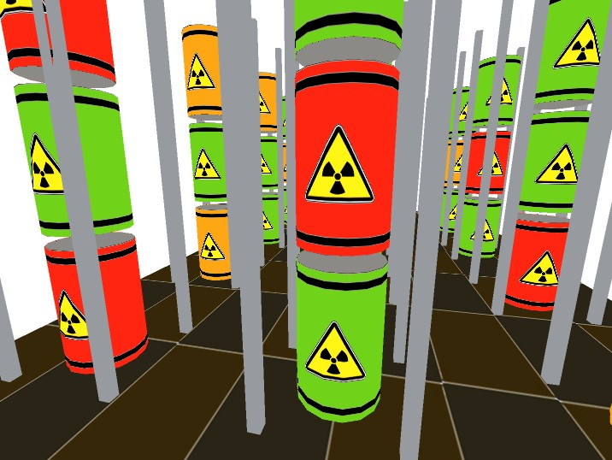
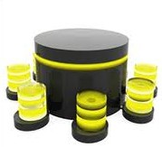

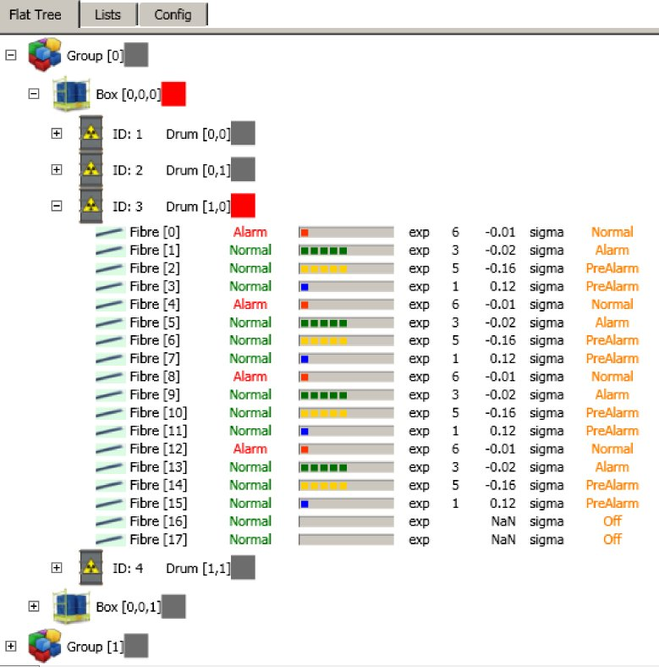
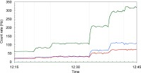
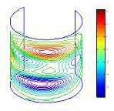

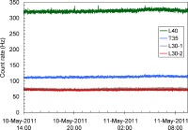

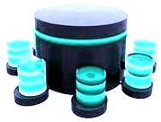
On-line remote monitoring of radioactive waste repositories
Alfio Pappalardo, Luigi Cosentino, Claudio Calì, Pietro Litrico, Sergio Scirè, Carlotta Scirè, Gianfranco Vecchio and Paolo Finocchiaro
INFN Laboratori Nazionali del Sud, Catania, Italy
A.Mariani, S. Alfieri
SOGIN S.p.A
local
data
storage
wireless
network
Web
Data
wired
network
remote
data
storage
DMNR
Detector Mesh for Nuclear Repositories

Slide 2

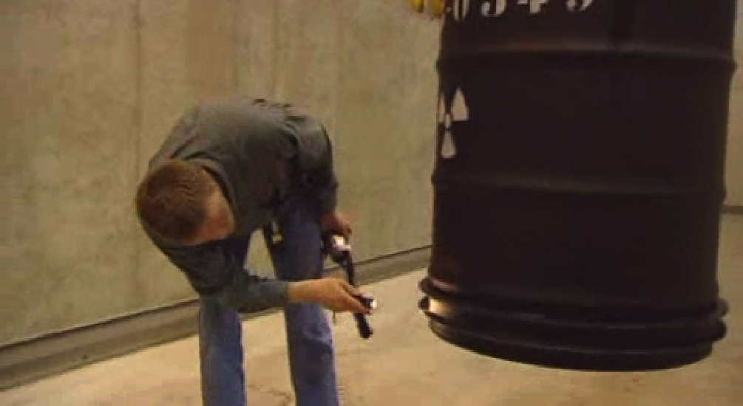
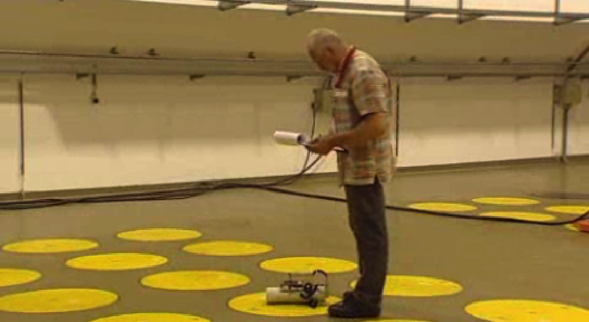
Radioactive waste confined into long-lasting drums
Problem
Radioactive waste produced worldwide generally sealed in special drums
The storage site should be monitored for leaks, to prevent possible contamination of people and the environment
What can we do?
DMNR project
Topics
On-line monitoring of short/medium term radioactive waste storage
Application of non-conventional detectors for decommissioning
Goals
real-time monitoring: activity, mechanical stability, etc.
radwaste handling by means of advanced tools and procedures suitable for reducing the risks to the local workers and to the population

Slide 3
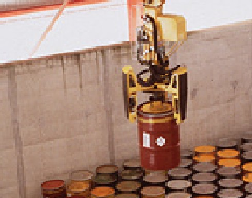
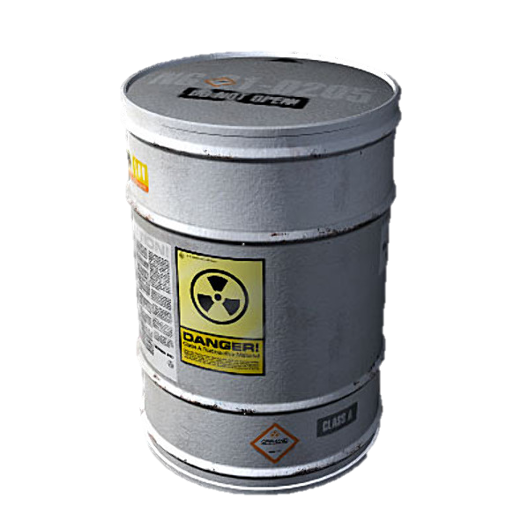

Why do we want to monitor?
We want to have a complete and detailed record of the history of each drum.
Accidents may happen, most likely:
drums might be damaged while being
displaced (mainly for inspection!)
the concrete matrix containing the waste
might crack (and leak out)
liquid waste?????
What would be desirable?
individual and continuous online monitoring of drums, even during possible displacements
Basic radioactivity coming out is gamma rays
better, never displace the drums, monitor them in place

Slide 4
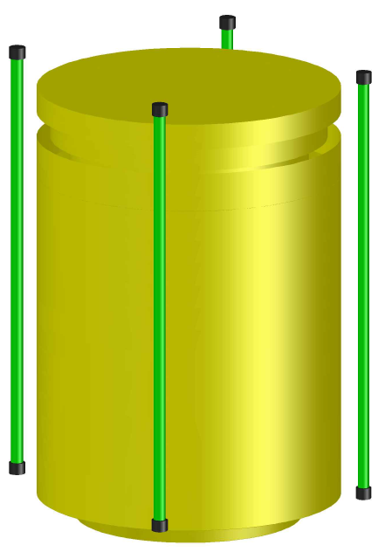
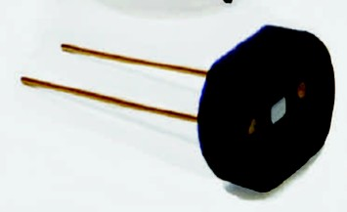
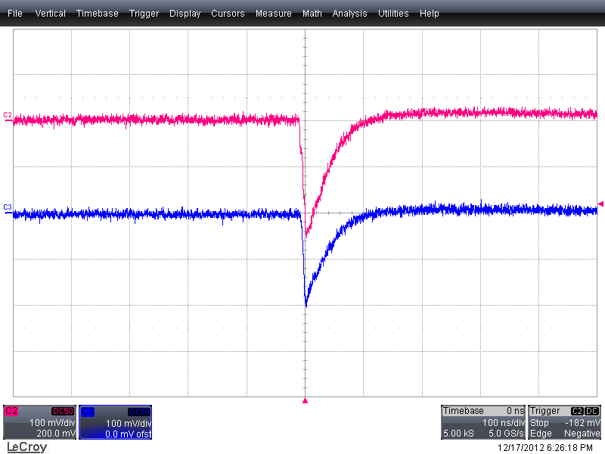
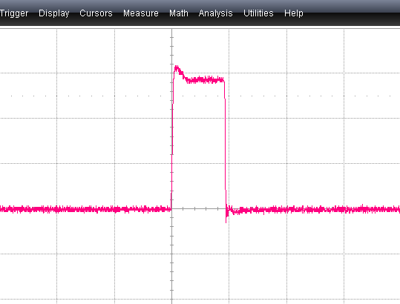

How do we want to monitor? → Basic sensor unit
Sensor requirements and goal:
SiPM
  radiation hardness yes several years close to
  a drum with 10-100 mGy/h
  robustness yes, plastic scintillators; SiPM not
  damaged by ambient light exposure
  low efficiency, high sensitivity yes
  reliability yes
  low cost yes
Whenever radiation stimulates the fibre, a tiny light pulse is produced (few photons), and the SiPM is capable of detecting it
SiPM
SiPM
Fiber
SiPM
Coincidence circuit
Counts/s
Signal coincidence

Slide 5
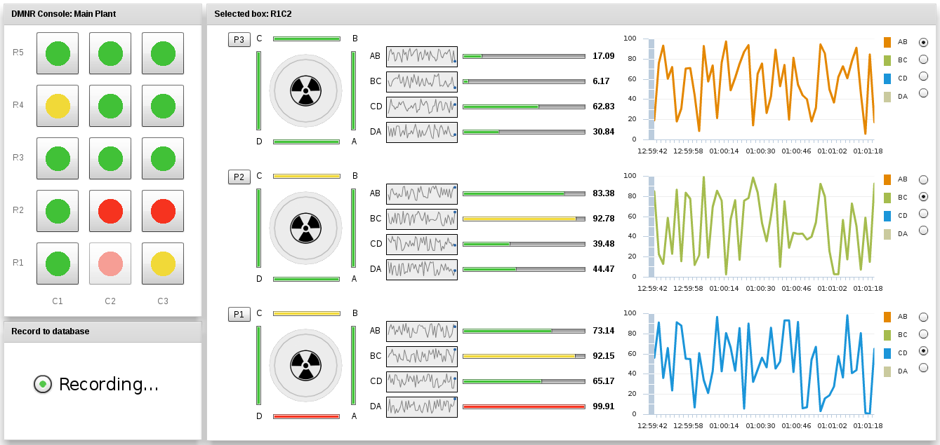
Repository: 3-D map sketch
Counts channel by channel
Available details on every single drum
Alarm
Pre-alarm

Slide 6
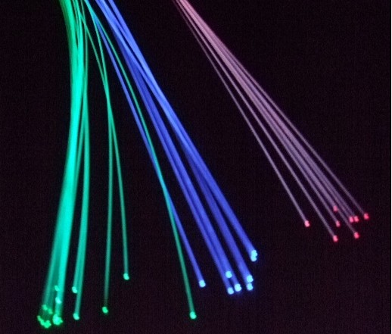
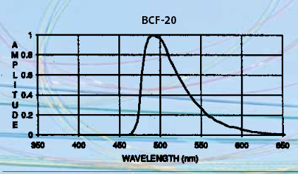
Detector: scintillating fiber
Collecting light efficiency at one end of the fiber ≈ 3.5%
Ionizing
radiation
θ_{tr}
θ_{tr}
core
cladding
Scintillating fiber
Emission spectrum
Core → Polystyrene
Decay time: ~3ns
Diameter → 1 mm
L_{att} → > 3.5m
λ_{emis} → 480nm
Entrapment efficiency → 3.5%
Light yield ~ 10⁴ photons/MeV

Slide 7
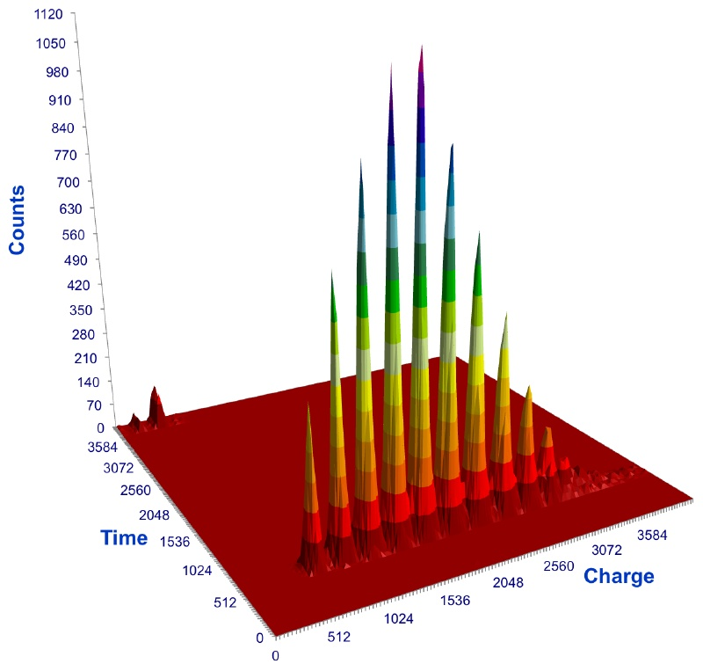
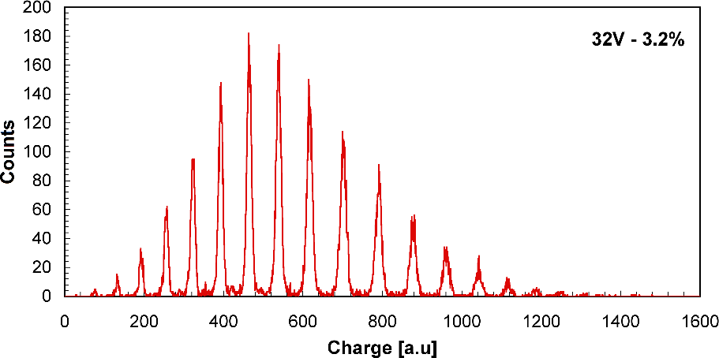
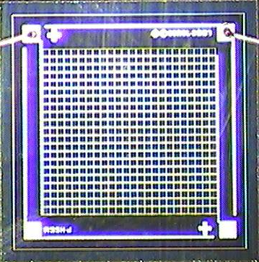
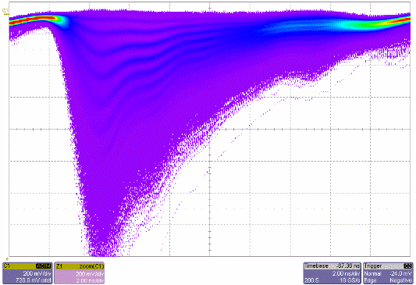
SiPM: response to light
1mm x 1mm
576 cells SensL
SiPM → SiliconPhotoMultiplier
array of a Single Photon Avalanche Diode (SPAD) biased beyond breakdown (Geiger mode)
the avalanche is quenched by means of integrated resistors
Sensitive to single photon
7
8
Iluminated with laser light
Bias at 32V
Resolution power >100
6
9
10
5
11
4
12
3
13
14
1
2
15
16
SiPM in use
measured charge Q (from QDC)

Slide 8
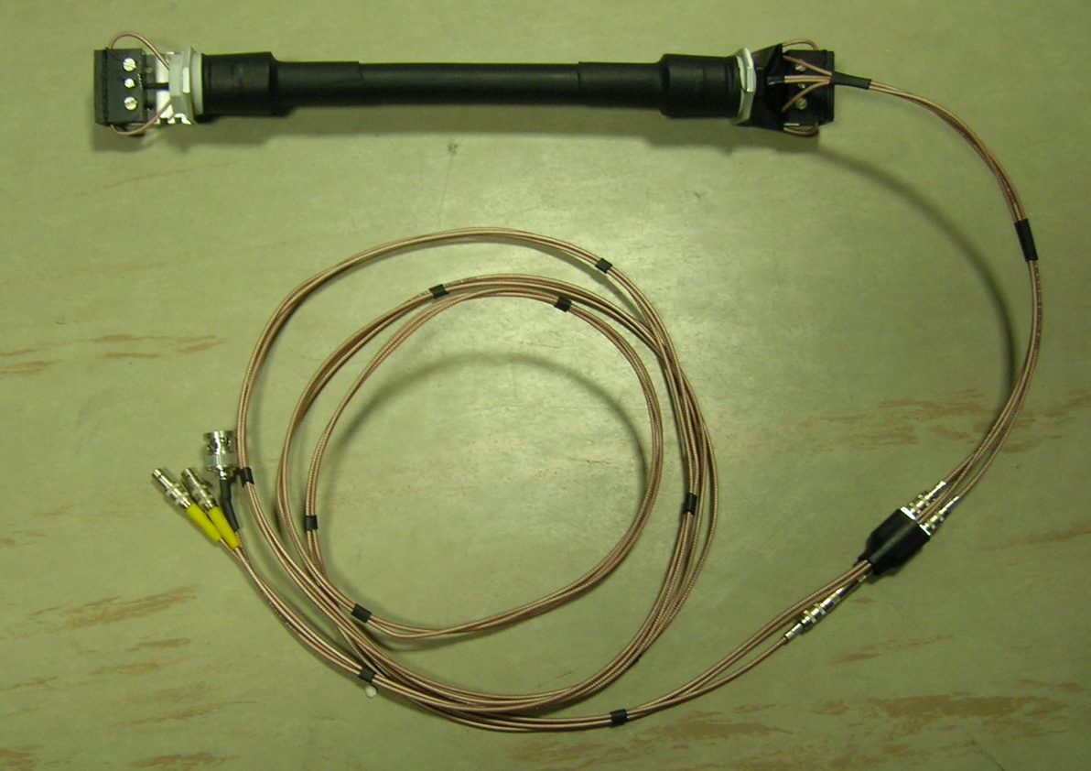
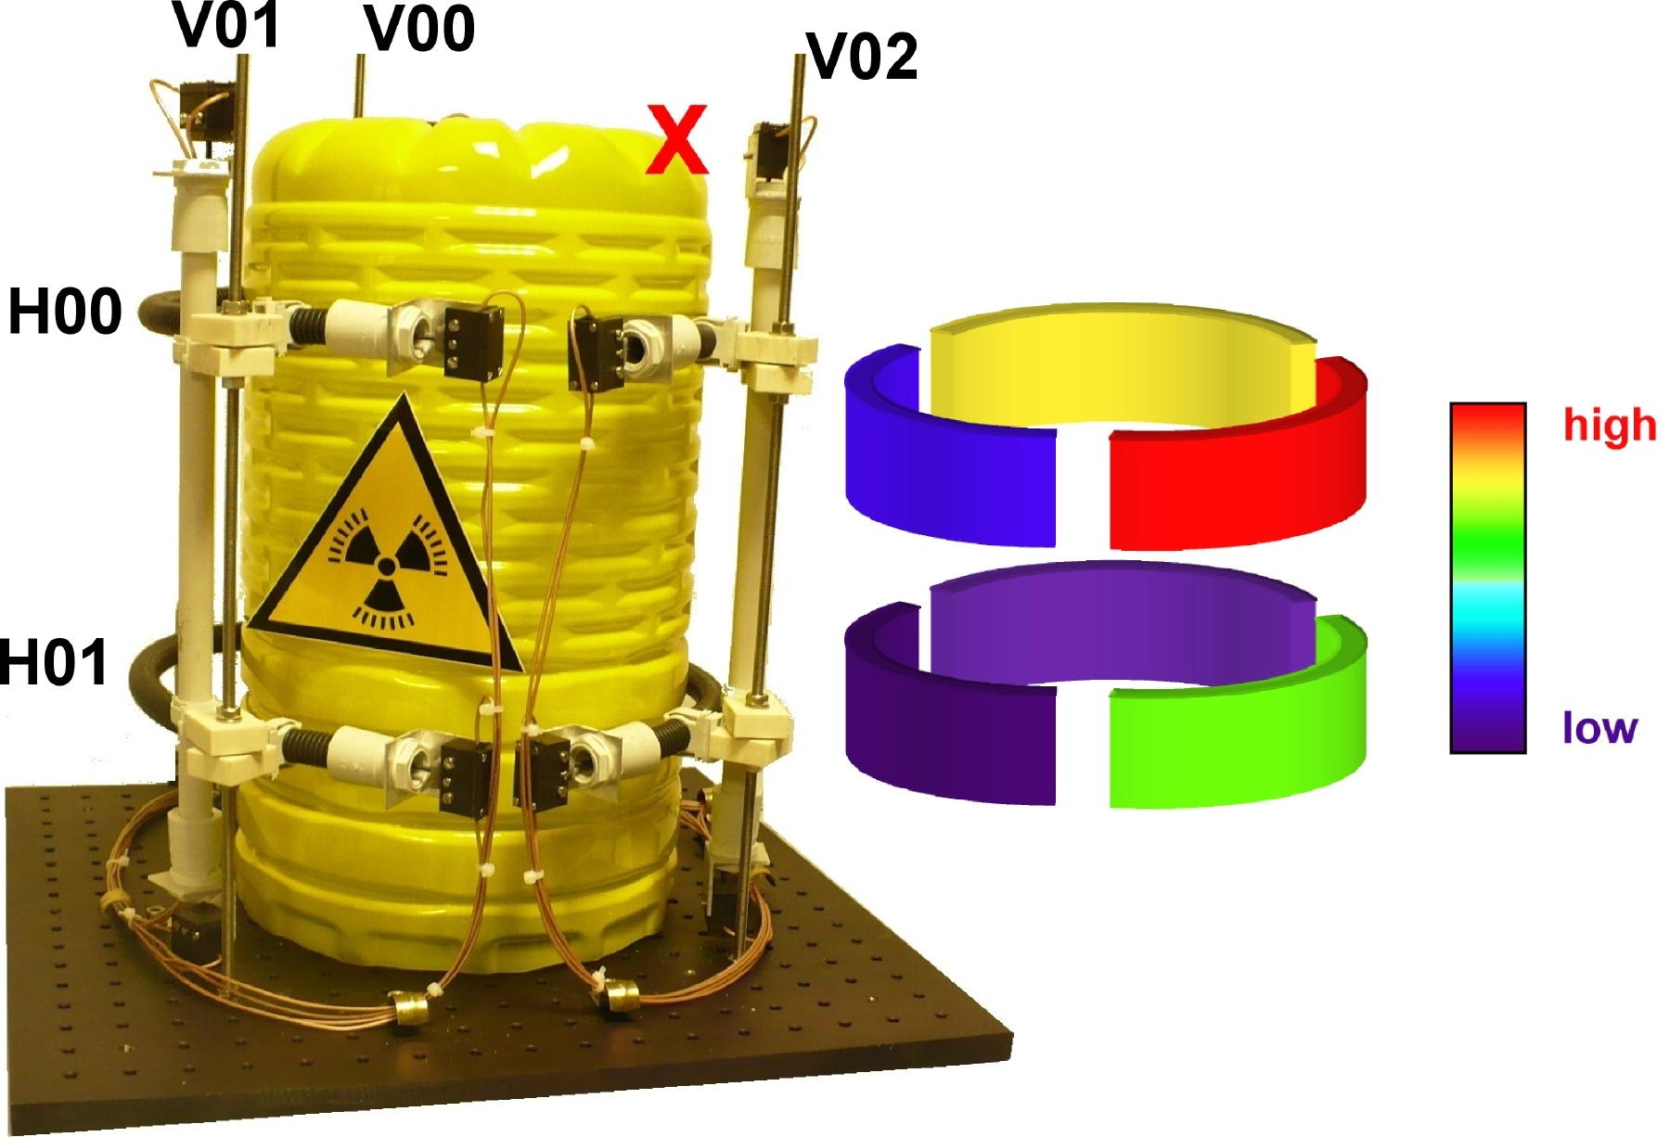
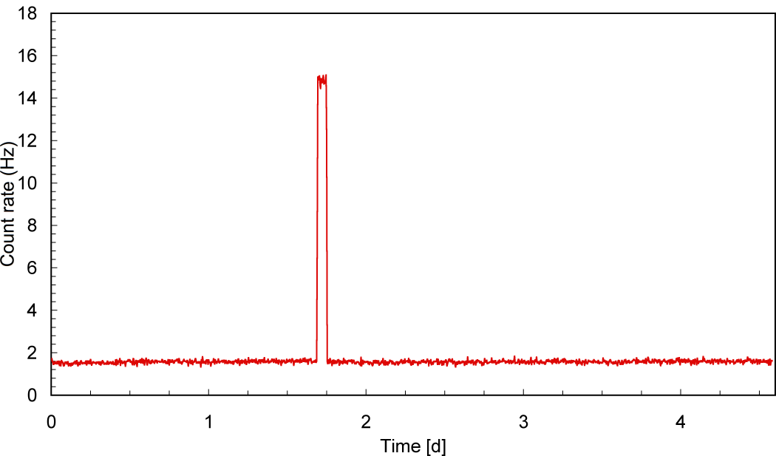
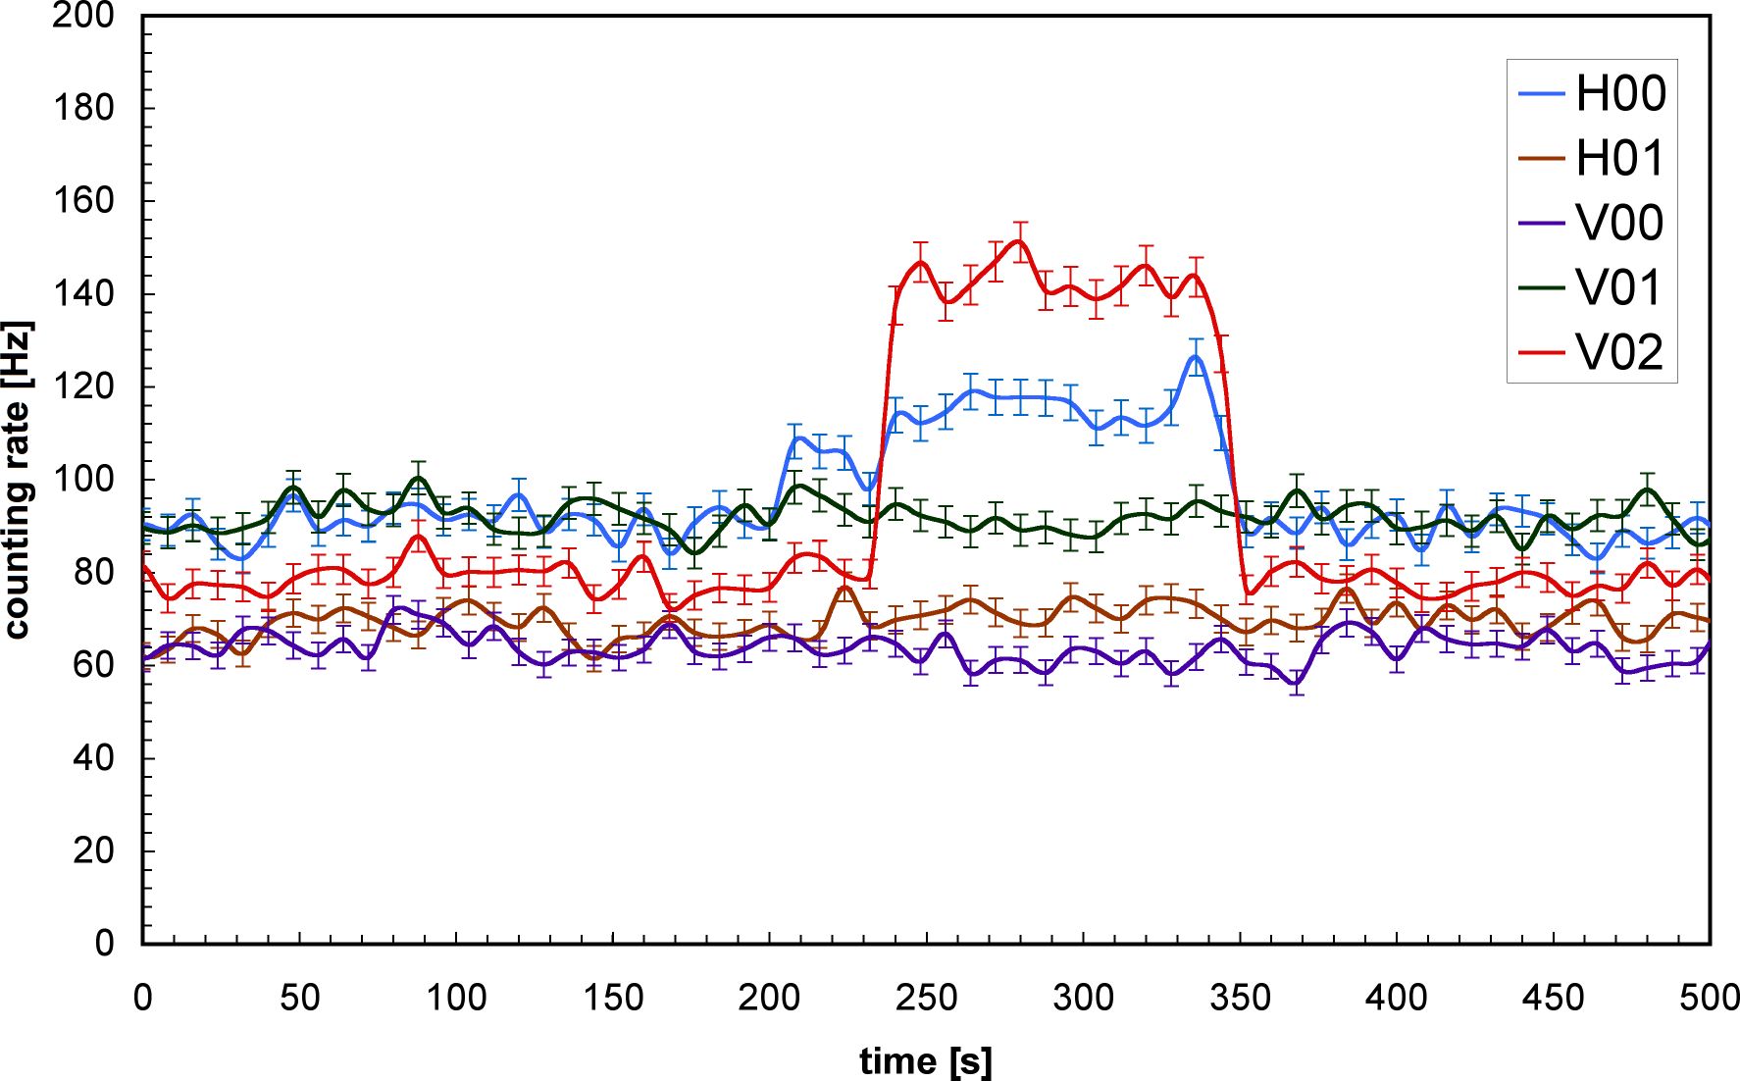
Detector test
3D reconstruction by crossing fibers
2.7MBq source at 10cm
background
background

Slide 9
µSB - new low noise sensors
μSB → new sensors version
μSL → old sensors version
µSB
µSB
µSL
µSL
test with ²⁴¹Am, ²²Na, ¹³⁷Cs, ⁶⁰Co sources
Intrinsic efficiency: between 10⁻² - 10⁻⁶

Slide 10
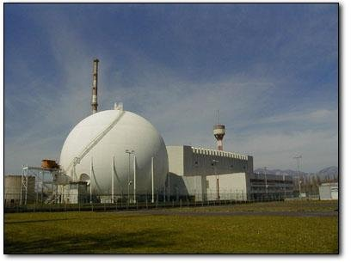
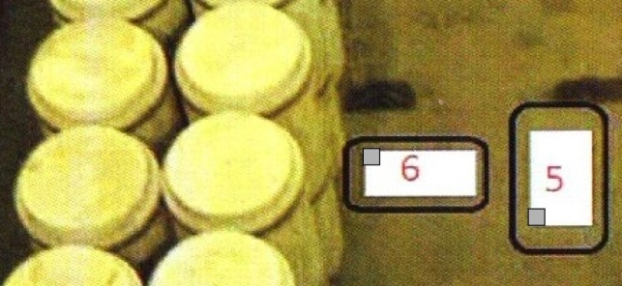
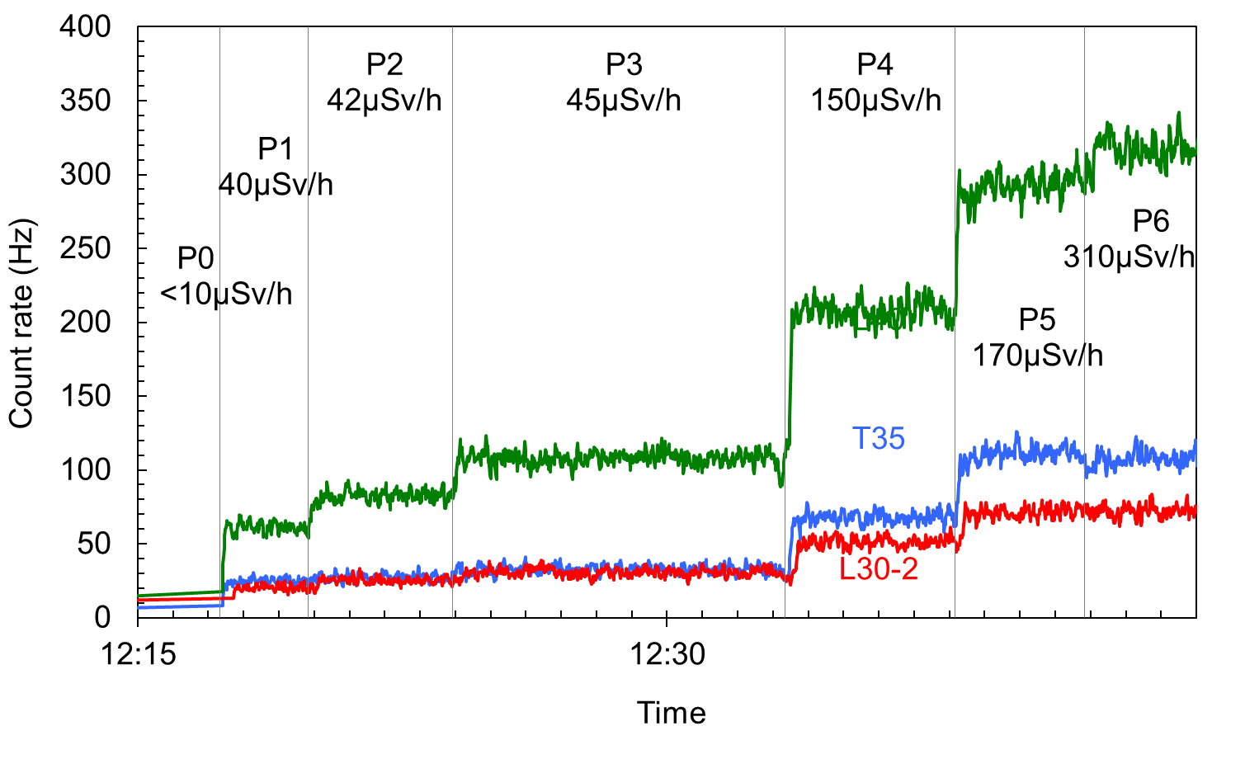
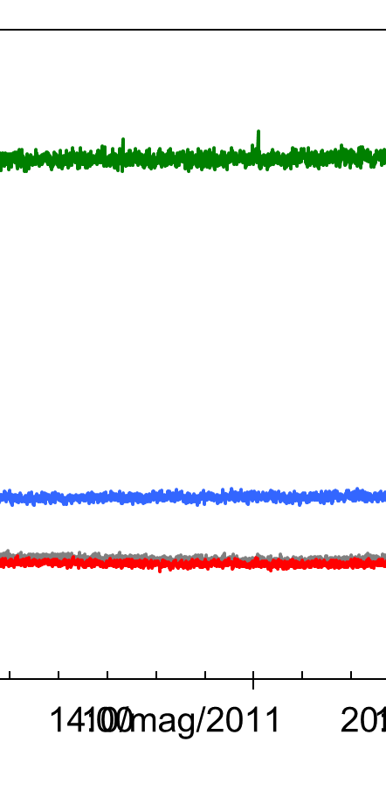
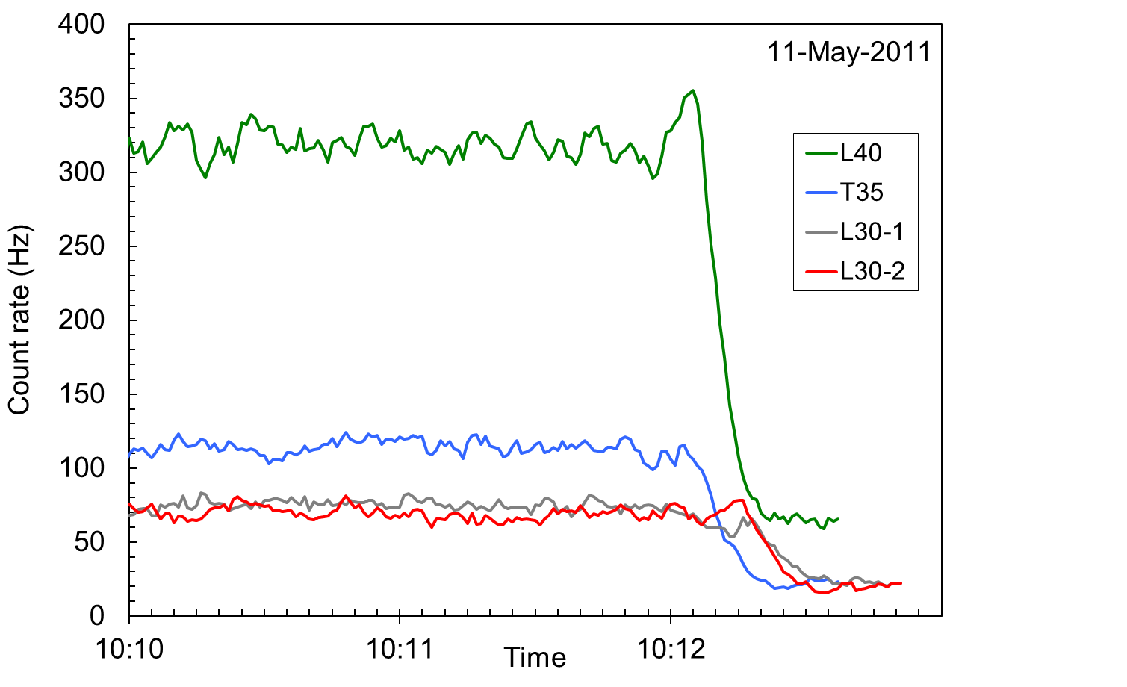
Real waste drums test
preliminary test with real radwaste drums in a storage site inside the former nuclear power plant of Garigliano (SOGIN S.p.a.)
4 sensors (+ geiger) on a trolley
7 different positions
Growing dose rates
Test starting
all night
Test finish

Slide 11
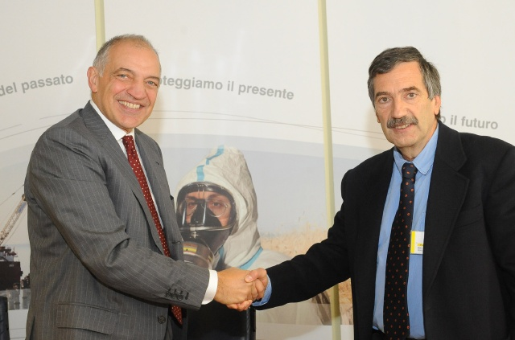


Collaboration agreement between
INFN and SOGIN
signed on 7-Nov-2012
Project duration:
2 years
Theoretical and Experimental Research Institute in the fields of subnuclear, nuclear and astroparticle physics
environmental decontamination of Italy's nuclear sites
At the Garigliano storage site, a fraction of the drums will be equipped with the proposed solution

Slide 12
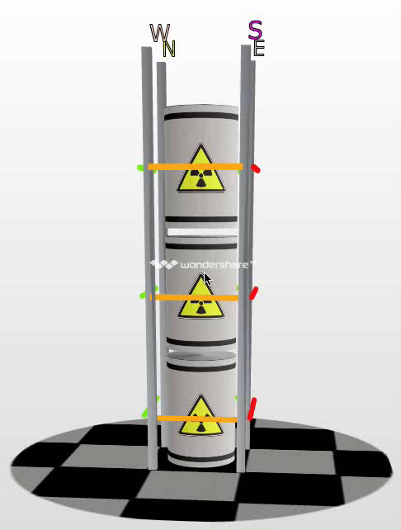
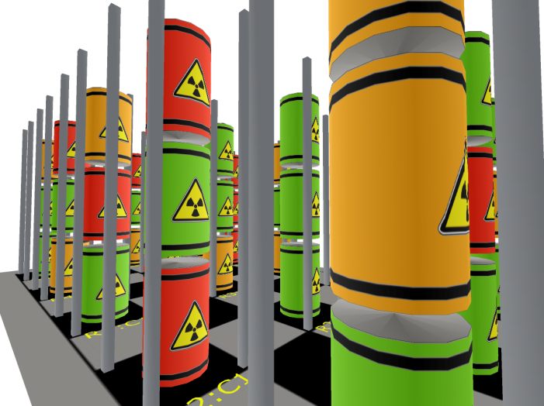
Next step (being installed at Garigliano)
connection to the sensor database
virtual 3D navigation

Slide 13
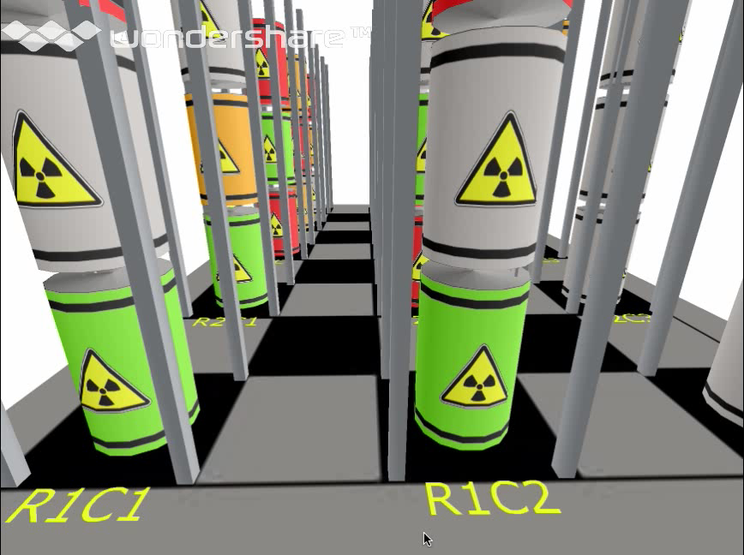
Virtual 3D navigation
INFN - LNS

Slide 14
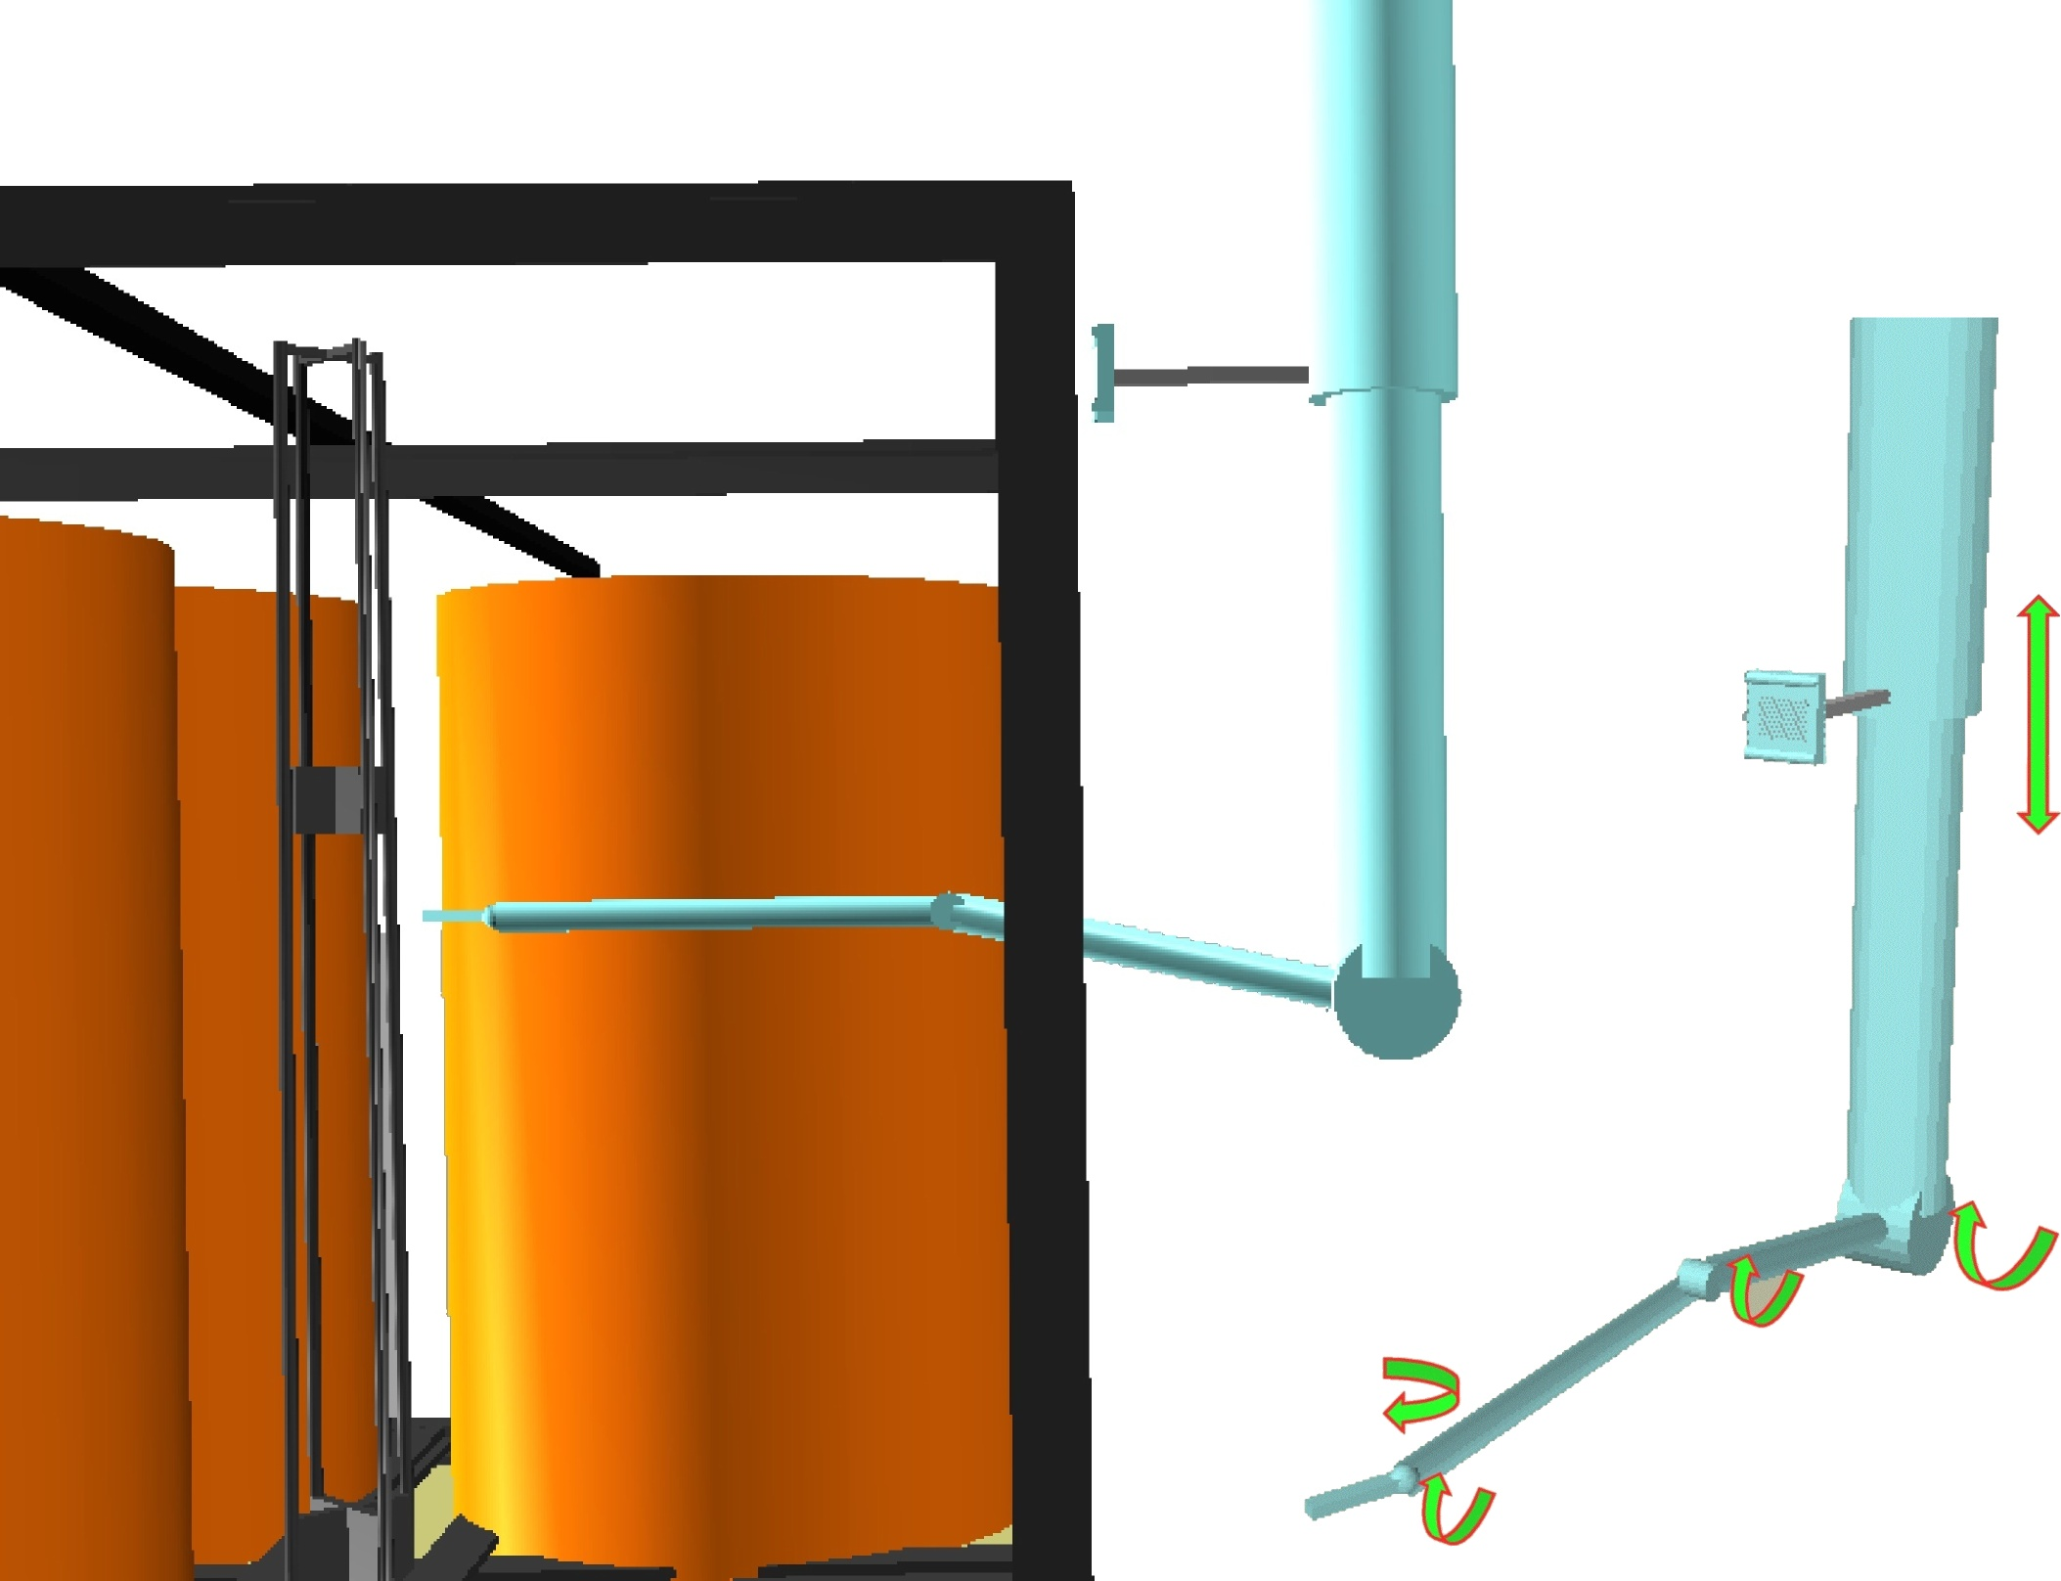
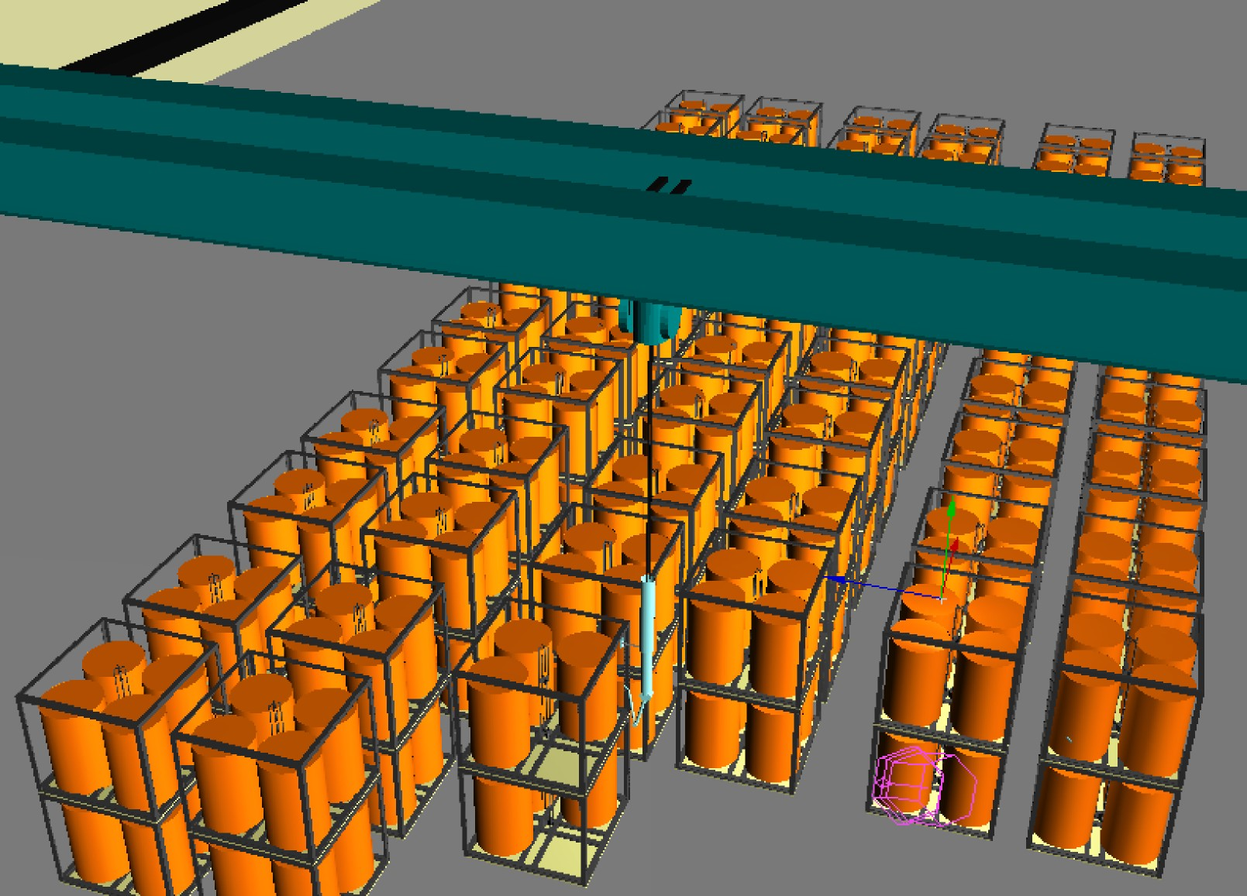

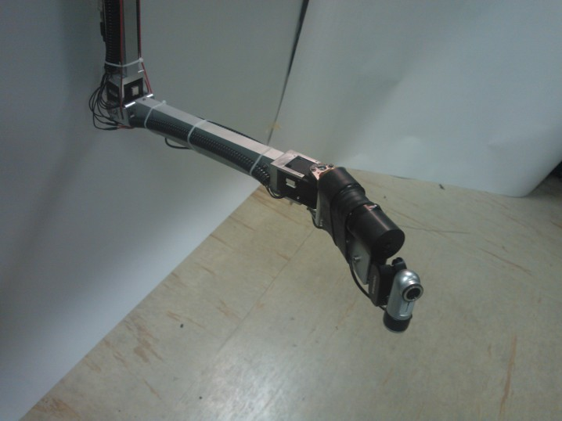
Drums inspection: robotic arm with remote control
5 degree of freedom
load:
CCD camera for visual inspectin
Gamma detector
See Luca Russo poster for more details

Slide 15
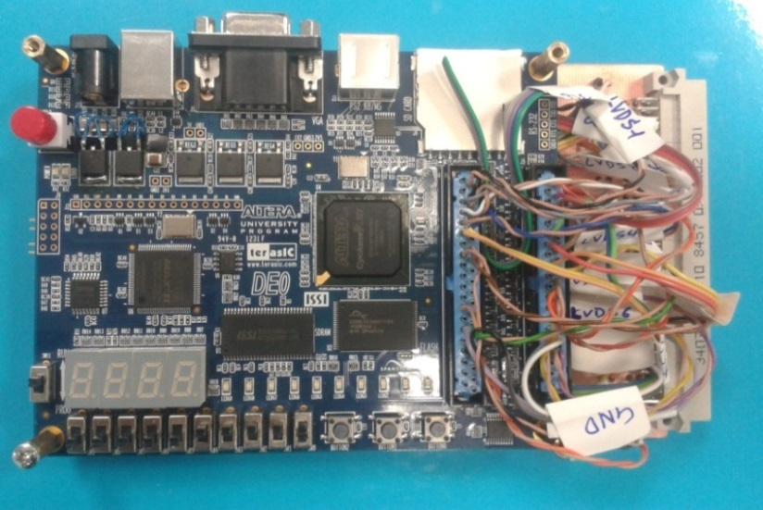
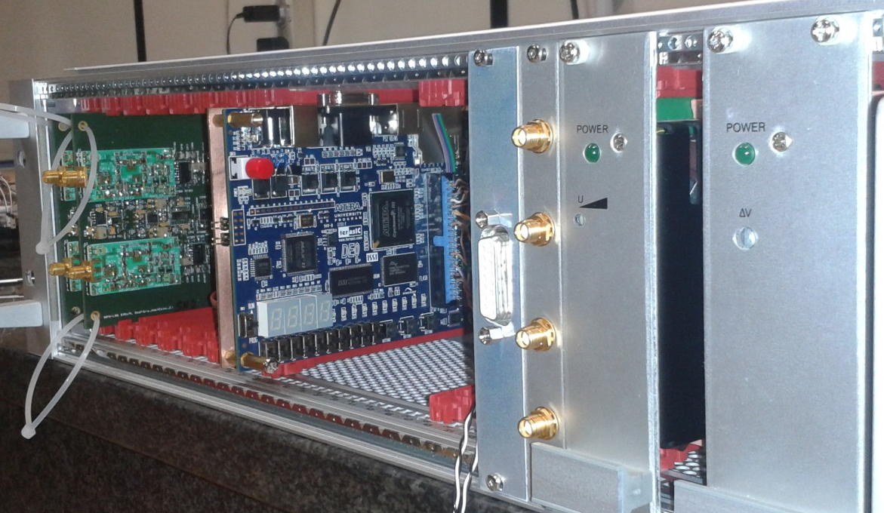
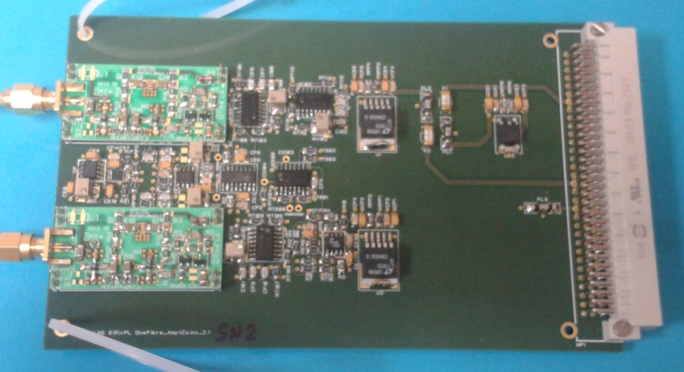
Current system improvements
FPGA
Remote
Operator
Local
Routines
FPGA
FPGA
Multidrop serial RS485 communication
Subrack 19’’ 3U 84 HP
Eurocard PCB module design
3U 19’’ rack mounting
VME-like backplane

Slide 16
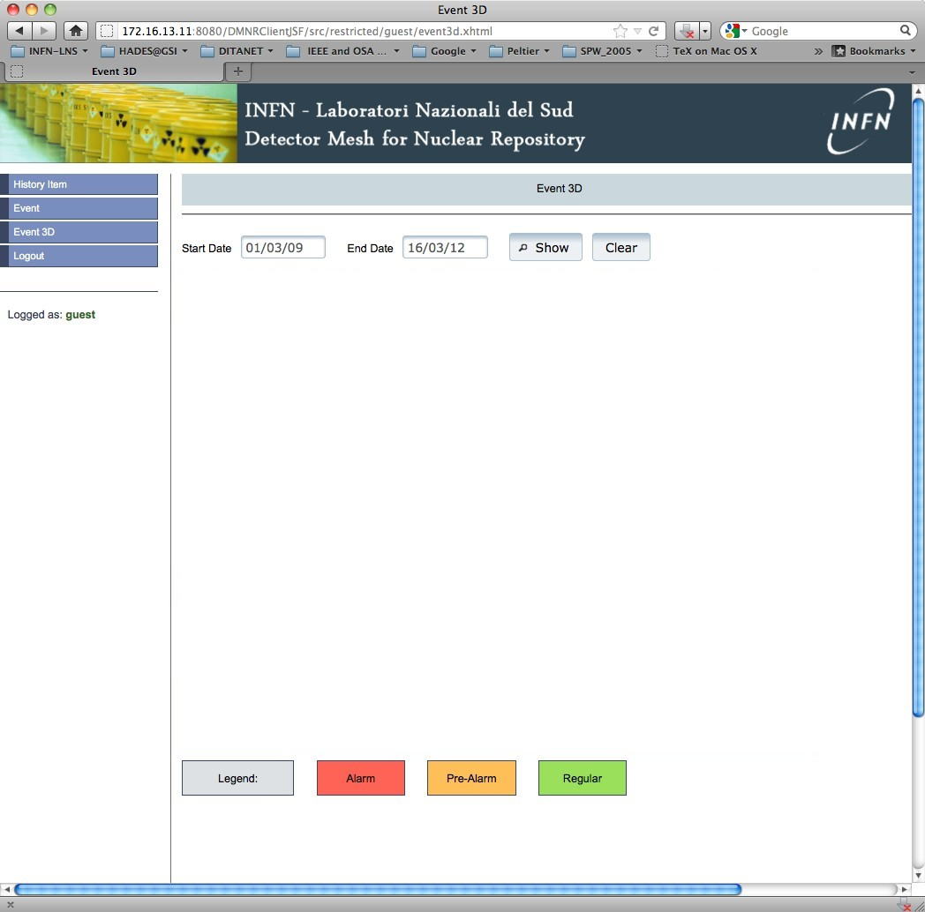

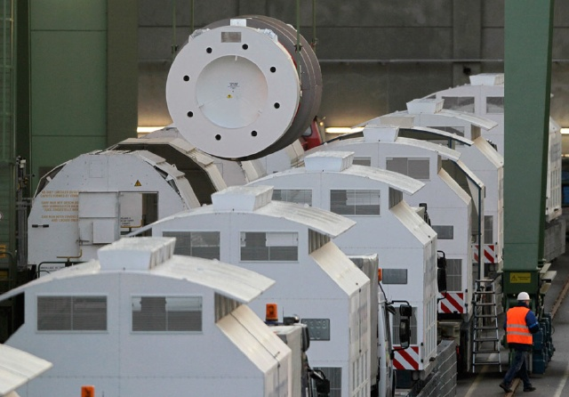

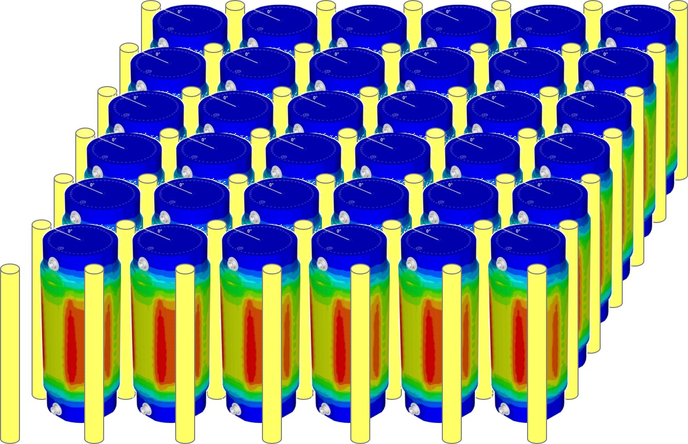
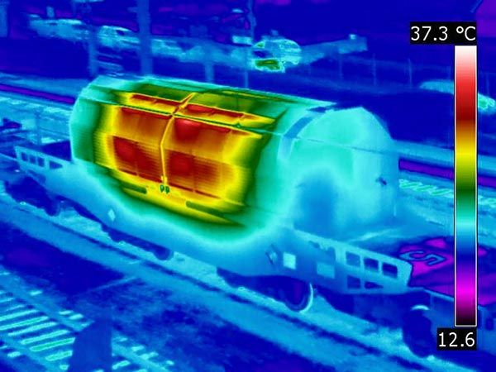
Real-time castor storage monitoring
JRC & Euratom collaboration
n detector
n detector
PET
moderator
n detector
Easy to implement the neutron
detection in the DMNR design:
electronic set-up
data acquisition
Graphical User Interface
data logging

Slide 17
Is it possible to detect thermal neutrons too?
σ(0.025eV) ≈ 940 b
thermal
range
n
³H
⁶Li
2.73 MeV
YES
⁷Li
2.05 MeV
⁴He
⁶LiF converter
See talk P.Finocchiaro, yesterday

Slide 18
Conclusion
  efficient real-time monitoring of radioactive waste
  low cost for detectors and data transmission
  fast identification of leak position
  reduce potential radiation doses to workers
  possibility to detect neutrons

Slide 19
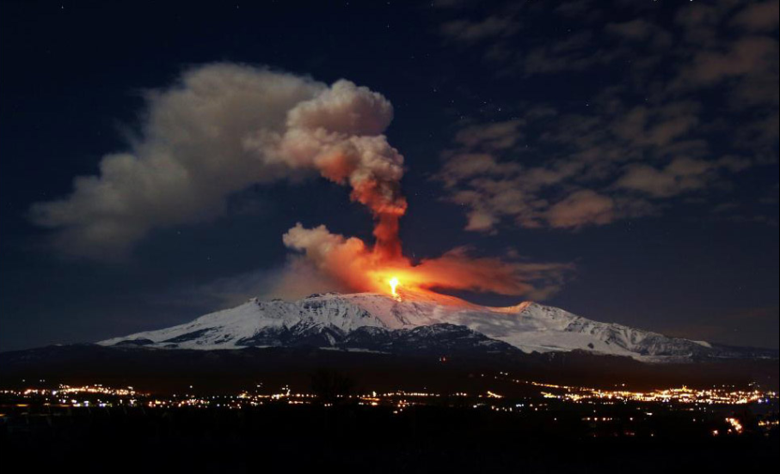
THANKS FOR THE ATTENTION

