Slide 1

PRESENCE BASED ADAPTIVE CONTROL FOR INDOOR BUILDING LIGHTING
M. Annunziato - ENEA
A. Antonelli – University Roma 3
M. Grossoni – University Roma 3
Stefano Pizzuti – ENEA
European Energy Conference
Budapest(HU), October 27-30th 2013

Slide 2

Summary
Introduction
Method
Experimentation
Conclusions

Slide 3
Introduction
Building energy consumption represents
30%-40% of the global energy consumption (United Nations Environment Programme, Buildings Can Play Key Role In Combating Climate Change, 2007)
40% of CO2 emissions (Yudelson, 2010)
the study of building energy demand has got in the recent years a remarkable relevance (European Union, Directives 2002/91/EC, 2010/31/UE , Nearly Zero Energy Building )
accurate control systems are the key for energy efficiency with remarkable economic and environmental advantages

Slide 4
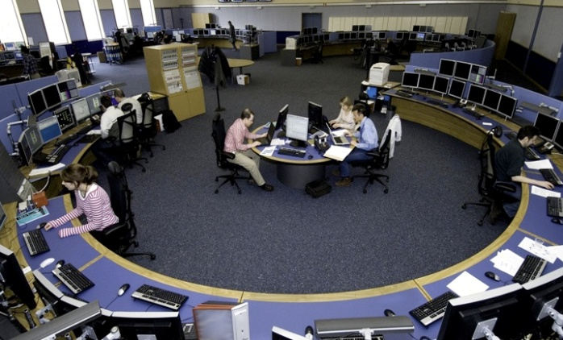
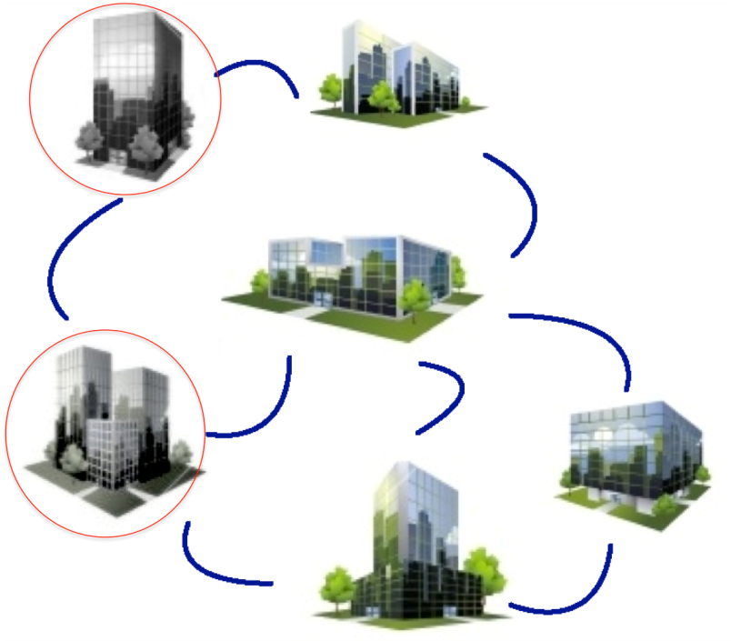



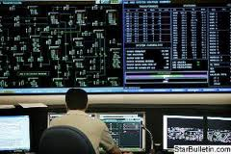

Building Network Management
managment
optimization
Network supervisorS
Network Intelligence
REMOTE
MONITORING
Cost/Energy
Optimization
Diagnostics intelligence
Active Demand Management
Grid distributor

Slide 5
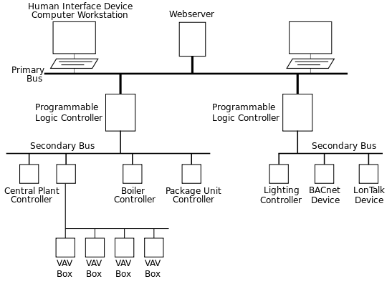
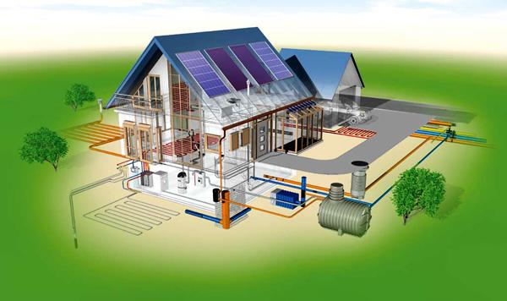

Introduction
A building automation system (BAS) is an example of a distributed control system.
The control system is a computerized, intelligent network of electronic devices designed to monitor and control the mechanical, electronics, and lighting systems in a building.
A building controlled by a BAS is often referred to as a smart building.
diagnostics
data
alarms
Adaptive Control
(Energy on Demand)

Slide 6
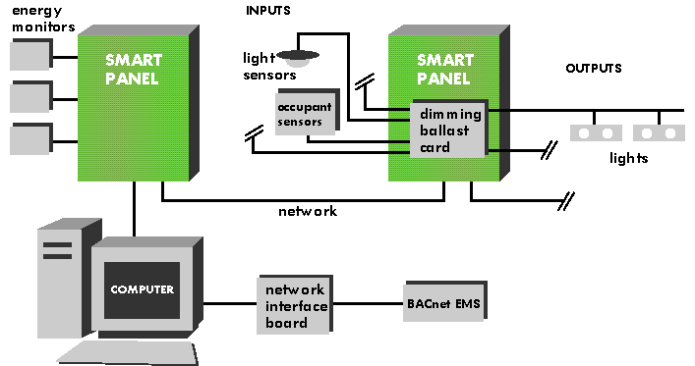
Introduction
A Lighting Control System (LCS) is an intelligent network based lighting control solution that incorporates communication between various system inputs and outputs related to lighting control with the use of one or more central computing devices.
LCS serve to provide the right amount of light where and when it is needed.

Slide 7
Method
Goal : to develop a control strategy which allows the lights of common spaces (like corridors) to be automatically switched off when the building (or parts of it) is almost empty.
Task : to develop a control rule which can balance disconfort and energy saving, thus a rule where the threshold parameter is such that it can be a good compromise between energy saving and users satisfaction.
If n_{t}<ε then lights=0

Slide 8
Method
offline study
11 months (from december 2011 to october 2012) real data (lighting energy consumption, occupancy) of an office building
Three floors, about 50 people
Manual control
Goal : calculate the amount of energy which would have been saved if the control rule defined above had been applied

Slide 9
Method
If n_{t}<ε then lights=0
ε | Floor 0 | Floor1 | Floor 2
1 | 1 | 1.3 | 0.9
2 | 1.5 | 1.4 | 1
3 | 2.3 | 1.5 | 1
4 | 3 | 1.5 | 1.1
5 | 3.8 | 1.5 | 1.1
6 | 4.1 | 1.5 | 1.2
7 | 4.1 | 1.6 | 1.2
8 | 4.1 | 1.7 | 1.3
Average daily energy saving (kWh)

Slide 10
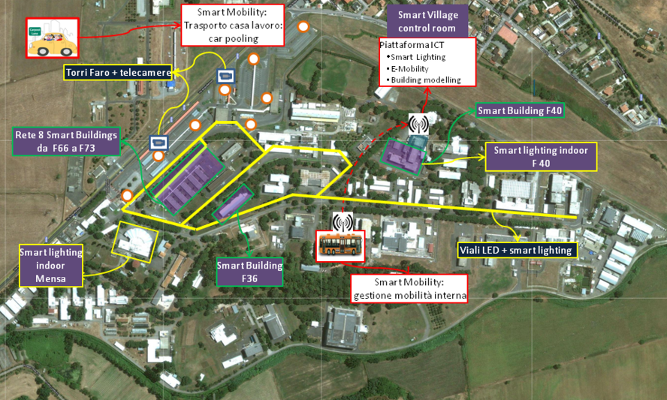
Experimentation
The ‘Casaccia’ Smart Village
Smart
agents
Smart
Village GUI
Village cloud
Distributed
Energy
Building
Network
Outdoor
Lighting
Mobility
Communication
Intelligence
level
Smart Village
Integrated management
resource on demand
buildings, sensors, low level control, local GUI
lamps, remote management, dimmering, local GUI

Slide 11

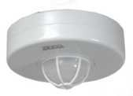
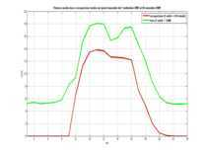
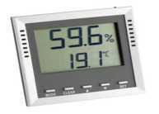

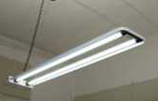



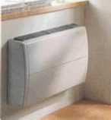
Experimentation
Smart Building
Presence
Consumptions
Data
Fusion

Slide 12
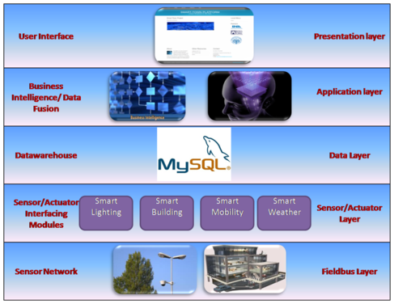
Experimentation
Smart Building : ICT
BEMS

Slide 13
Experimentation
Manual control vs on line adaptive control
It has been carried out on the same building where the preliminary study has been done → real data.
Manual : october to november 2012
Adaptive : february to march 2013

Slide 14
Experimentation
 | Floor 0 | Floor 1 | Floor 2 | Total
Energy saving (kWh) | 260 | 76 | 683 | 1019
CO2 (kg) 1 kg of oil = 3,15 kg CO2 | 153,14 | 44,764 | 402,287 | 600,191
€ (0,2318€/kWh) | 60,27 | 17,62 | 158,32 | 236,20
-40% cut of energy consumption

Slide 15
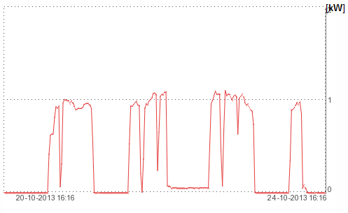
Experimentation
Adaptive Control in action

Slide 16
Conclusion
Demand Side Management : energy (lighting) on demand
The basic idea is that the lights of the common spaces (i.e. corridors) can be switched off, by a remote control system based on ict technologies, when the presence level is under a certain threshold
We carried out a study to properly set this threshold as function of the energy saving and then we applied the strategy on a real test case
Experimentation : manual vs. adaptive → -40% (real building)

Slide 17
Future work
Different final uses
  Conditioning
  Thermal
Clusters of buildings (10) → urban scale
Demand Response / Active Demand optimization

Slide 18
The End
Thank you for your attention
stefano.pizzuti@enea.it

