Slide 1
A Danish strategy combining fluctuating power production with international power exchanges
Paul-Frederik Bach
Danish wind power history and targets
Why nearshore wind parks? (Economy)
Why postponement? (Also economy)
Security of supply
  A European matter
  The Danish strategy
A European grid vision
  Common challenges
EPS Energy Group
Meeting in Brussels
13-14 September 2016

Slide 2
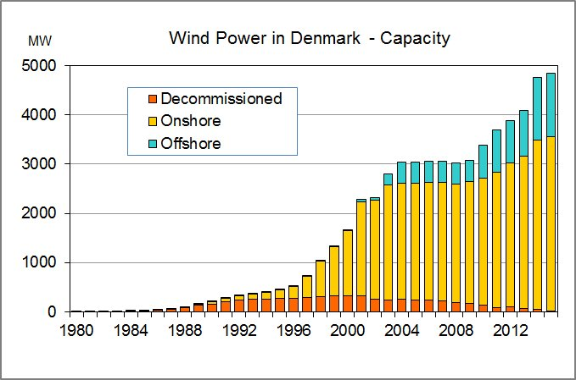
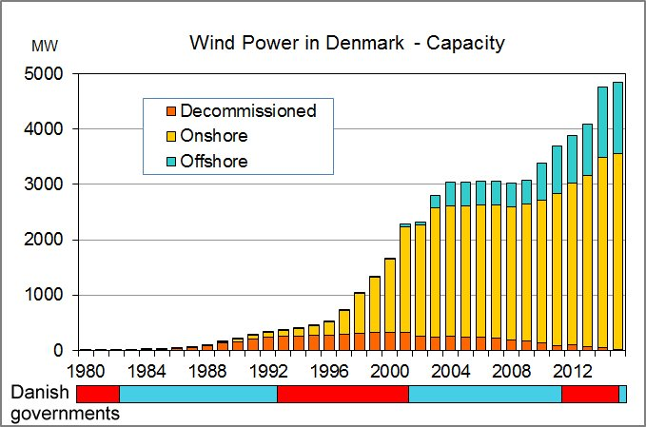
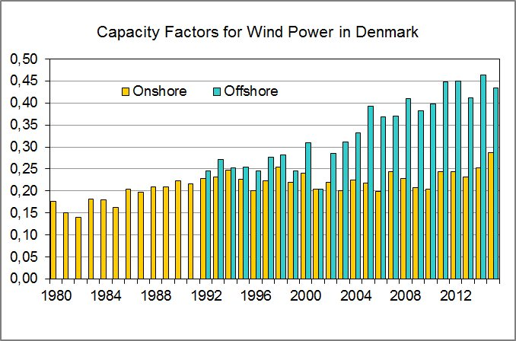
History and Targets
New offshore
New onshore
The short-term target is 50% wind electricity by 2020
Most parties agree on a fossil free society as the target for 2050

Slide 3
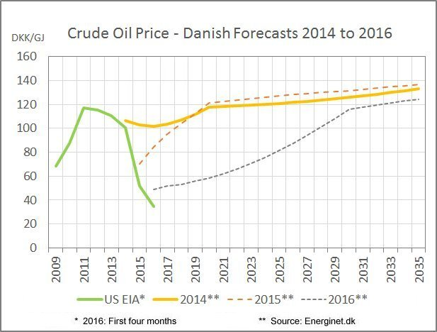
Three Fuel Price Forecasts
Economy 1
Fuel prices are unpredictable –
2020:
60 or 120 DKK/GJ?
(56 or 112 $/barrel?)
2014
2015
2016
A range from 30 to 120 DKK/GJ
could be possible
Crisis or not crisis?
Predicting crises?

Slide 4
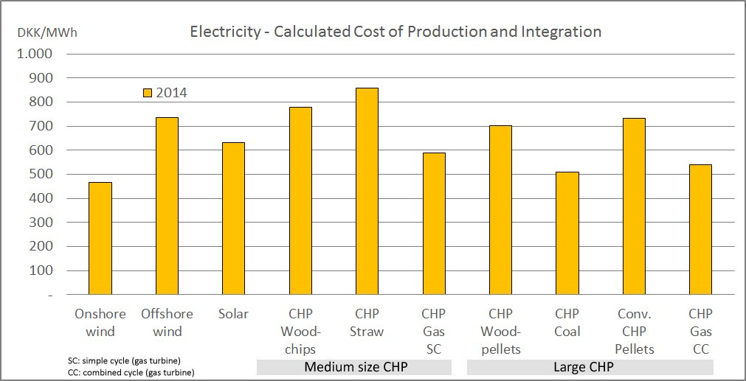
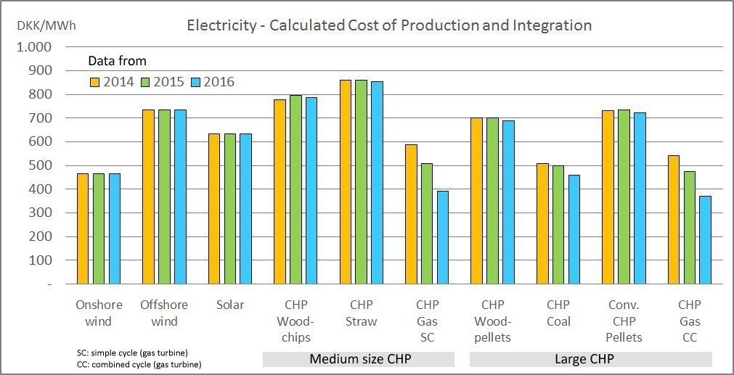

Calculated Electricity Cost from New Power Plants
Economy 2
Expensive technologies
  Offshore wind
  CHP biomass
Solar power
Cheap technologies
  Onshore wind
  CHP gas (SC and CC)
  CHP coal
DEA 2014:
A sensitivity analysis – (Three fuel price forecasts)
The fuel price forecast is the only difference between the three cases
Model and data: Danish Energy Agency (DEA) 2014/15

Slide 5
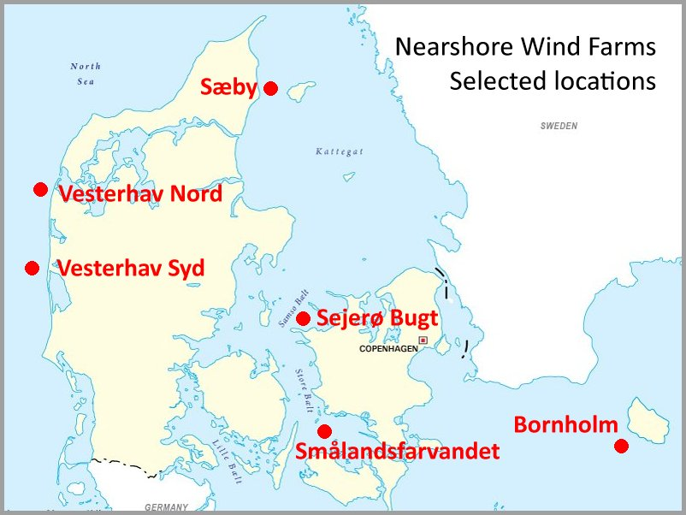
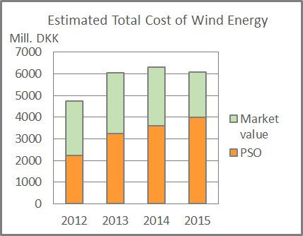
Nearshore Wind Farms
2012: Political agreement on new 1000 MW offshore and 500 MW nearshore wind parks until 2020
Resistance from tourist industry and local residents
2014: EU: Danish PSO subsidies are not legal
2015: Tender document on 350 MW nearshore wind farms
  Price ceiling: 700 DKK/MWh
2016: Concern about the cost of wind power:
  The subsidies are increasing
  The EU problem may eventually move the subsidy cost from electricity consumers to the state
The government wants to postpone the final tender for both offshore and nearshore wind parks

Slide 6
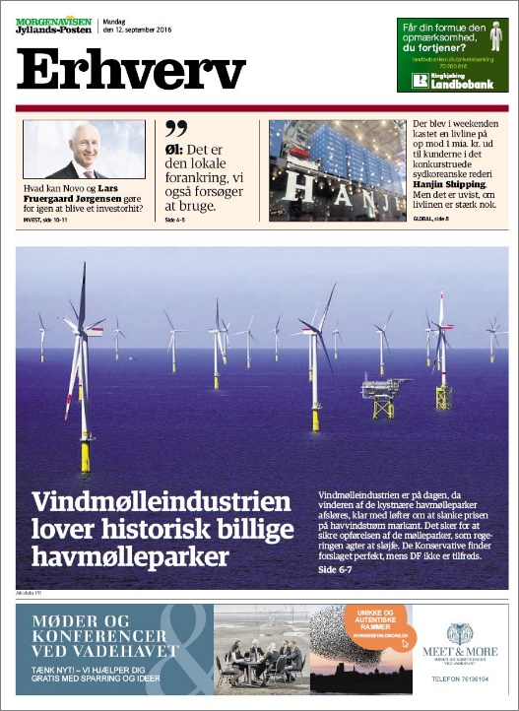
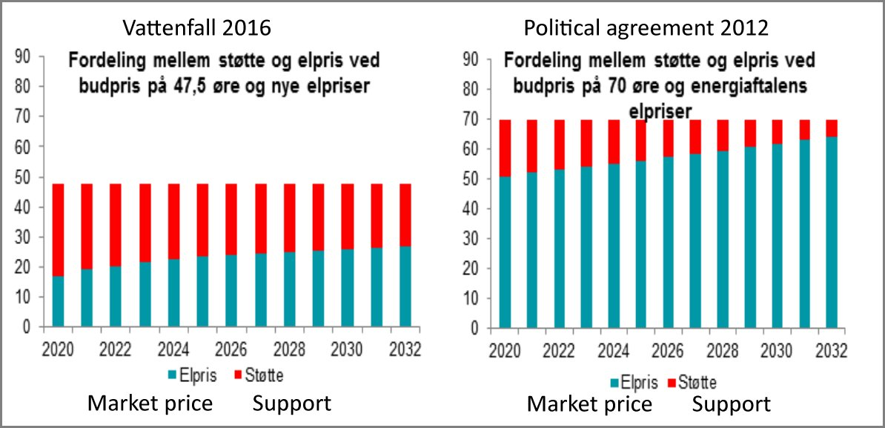
Latest news
12 September 2016 - Morning
”Wind industry promises historically cheap offshore parks”
12 September 2016 - Noon
Vattenfall proposal wins:
350 MW nearshore wind parks: 475 DKK/MWh
Government:
Necessary support will be much higher than assumed in the political agreement from 2012 due to new energy price forecasts.

Slide 7
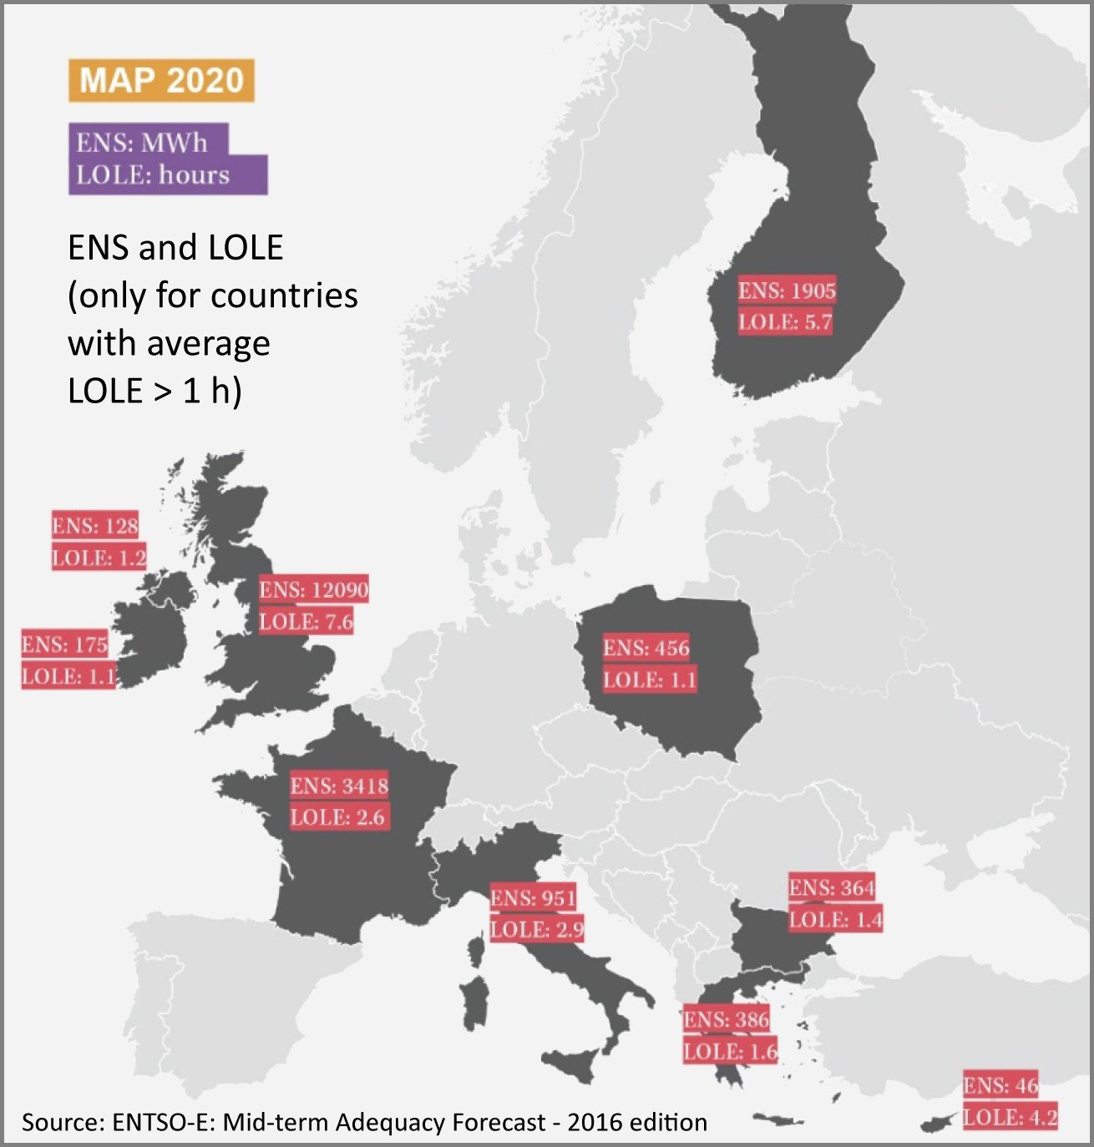
Security of supply in 2020
A European matter
The ENTSO-E 2016 adequacy forecast
  Based on four different statistical methods
Quantifying security of supply
  ENS: Energy Not Supplied
  LOLE: Loss Of Load Expectation
  The calculations include interconnectors and their reliability
  The 2020 results are average values for the four tools
  Traditional security requirement: LOLE < 1 h/year
Denmark is expected to have acceptable security of supply in 2020
  High interconnector capacity offsets lack of dispatchable capacity
GB: LOLE = 7.6 hours
  The calculations were based on National Grid’s “Gone Green” scenario, but with conservative assumptions on interconnector capacity.
  The adequacy forecast 2016: The British capacity market will prevent capacity problems.

Slide 8
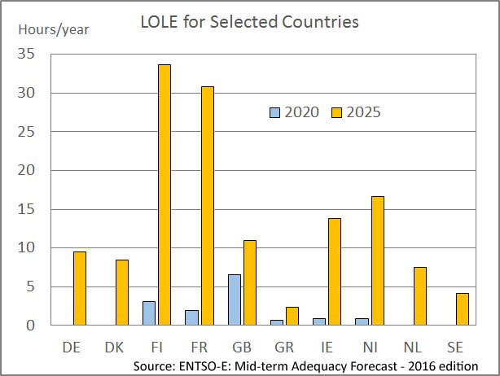
Security of supply in 2025
Results for 2025 are not available as a map
Only results for 3 of the 4 methods available for 2025
The chart compares average results for 10 countries. The results from 2020 and 2025 are based on the same 3 methods.
ENTSO-E:
  “An increase in the occurrence of adequacy problems is observed in the 2025 scenario compared to the 2020 scenario.”
Remember: One hour per year is the traditional security limit
The ENTSO-E message:
  “The results highlight the need for increased transmission capacity as well as increased usage of flexibility in the future power system evolution.”
The problem:
  The decreasing wholesale prices cannot justify investments in new production capacity
  Therefore all countries are discussing adequacy strategies

Slide 9
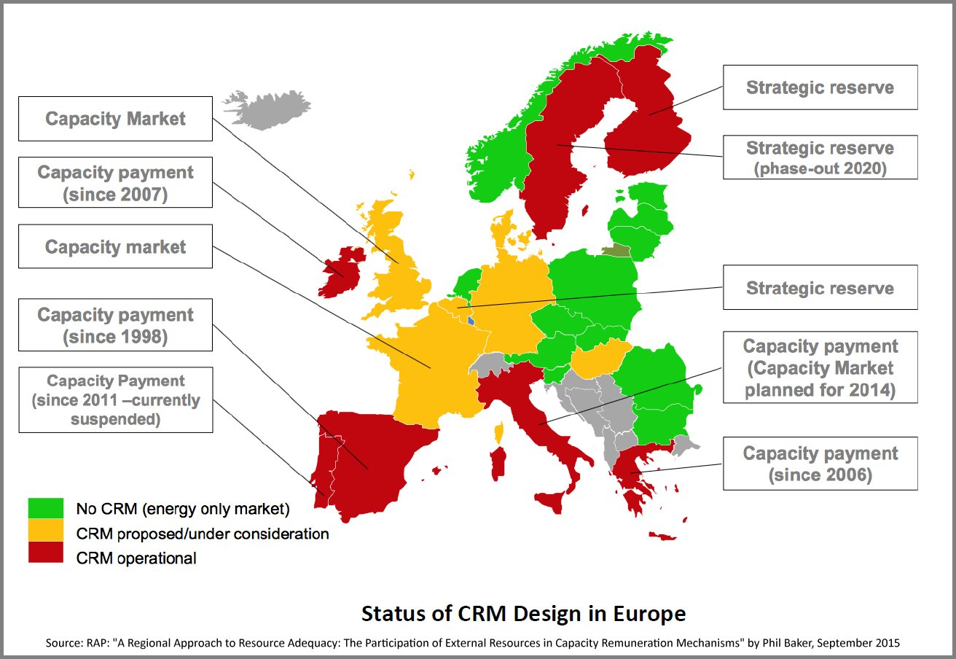
Adequacy Strategies
Capacity Remuneration Mechanisms (CRM) *
  Give a capacity payment to available capacity
  Strategic reserves (i.e. reserves triggered by extreme market or system security circumstances)
  A (forward) capacity market
    Decentralized: between suppliers and capacity providers
    Centralized: between single buyer and capacity providers
  Reliability options (a financial instrument). Not further discussed, because never used in practice so far.
The EU countries are divided
  Different solutions - different phases
Bad odds for an efficient European electricity market
Thanks to elia for the explanation.
Source: "Understanding Capacity Remuneration Mechanisms" - Bruno De Wachter & Patrik Buijs (EMI – Economic Framework)

Slide 10
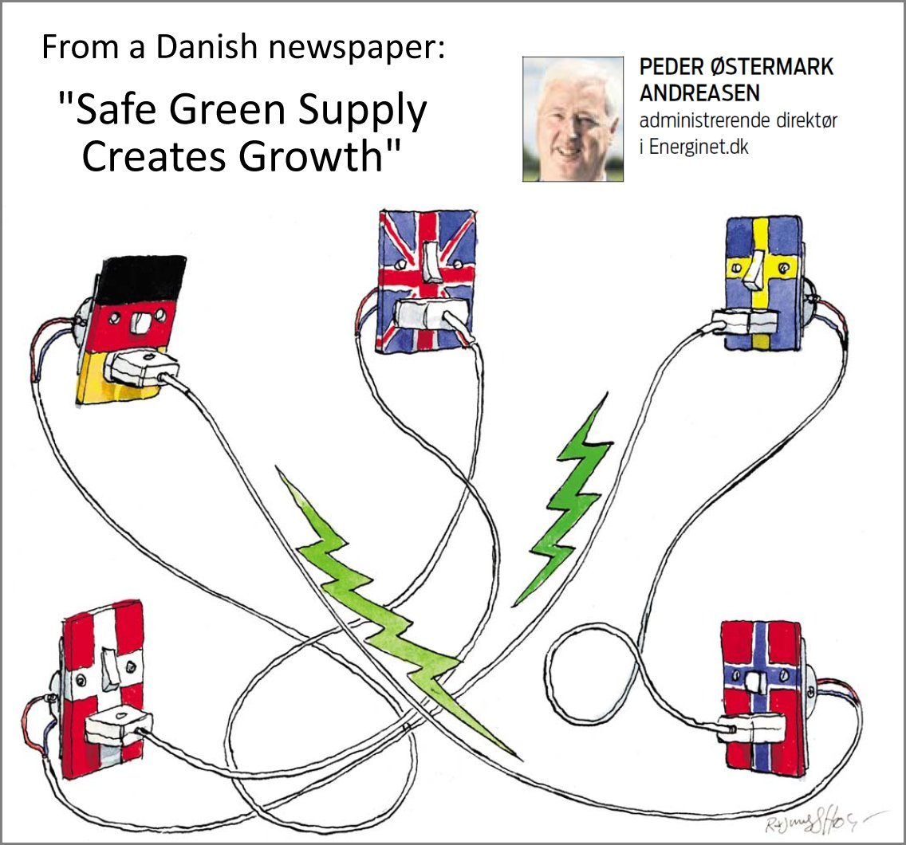
Denmark’s adequacy strategy
Denmark is a small country with large neighbours
Towards a fossil free society by 2050
Wind power as a main source of energy
  Lots of ideas about absorbing the wind fluctuations, but only modest action
Denmark is not self-sufficient, but relies on foreign reserves
Most regulating work is made abroad
Denmark maintains and develops its large import/export capacity
Within the family of “Strategic reserves”:
  A last resort, if foreign reserves are not available or too expensive
  Denmark is “sitting on the fence”

Slide 11
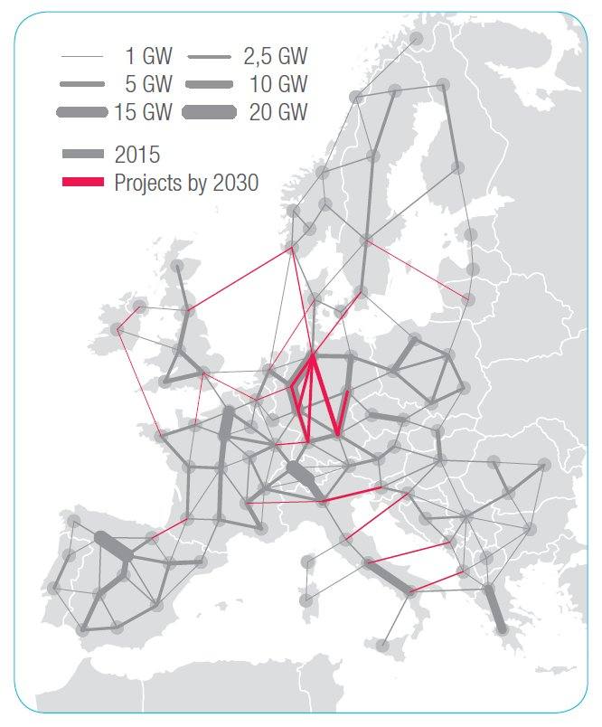
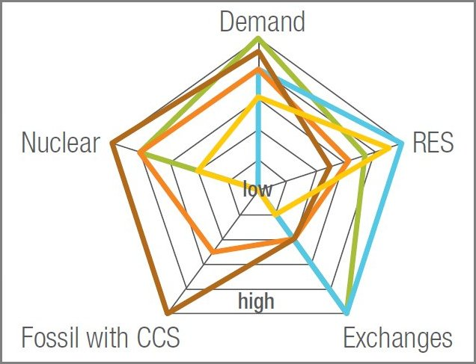
e-Highway2050 – A European Grid Vision
EU’s Seventh Framework Programme has supported a study on ways to remove 95% of the CO₂ emissions in EU by 2050.
Project homepage: http://www.e-highway2050.eu/results/
Grid reinforcements are supposed to absorb essential parts of the fluctuations caused by wind and solar power
Planned reinforcements are assumed to be commissioned before 2030 (particularly in Germany)
The five scenarios:
  Large-scale RES
  100% RES
  Big & market
  Fossil & nuclear
  Small & local
Start grid and reinforcements until 2030

Slide 12
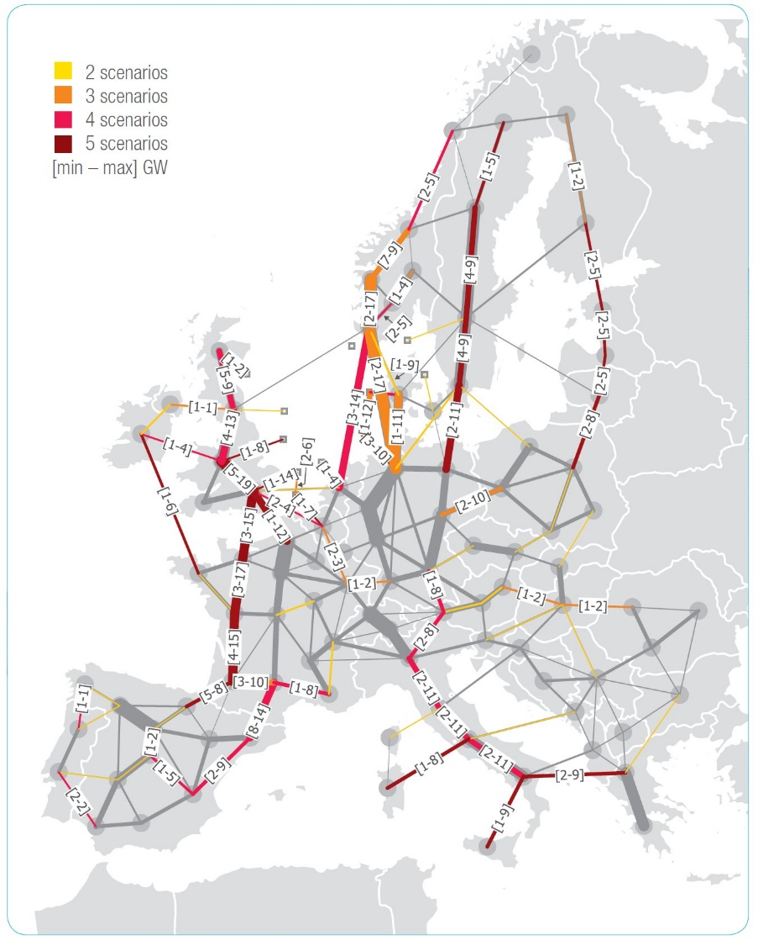
e-Highway2050 - Calculations
The study has its main focus on grid development
Different grids for the five scenarios
A western, a central and an eastern corridor
Cost estimates between 120 billion € and 640 billion €
  Cables or overhead lines?
Dispatchable generation between 30% and 78%
Different assumptions on not yet available technologies. Were they manipulated in order to meet CO₂ requirements?
  Energy savings: between 20% and 50%
  Demand Side Management: 12 to 78 GW (~0 GW in 2012)
  Storage: 65 to 113 GW (45 GW in 2012)
Results
  Energy not supplied: 0 TWh for all scenarios
  CO₂ emissions: 6 to 100 Mt (about 2000 Mt in 2010)
  Spillage: 1 to 308 TWh (GB consumption about 350 TWh)
Future grid corridors

Slide 13
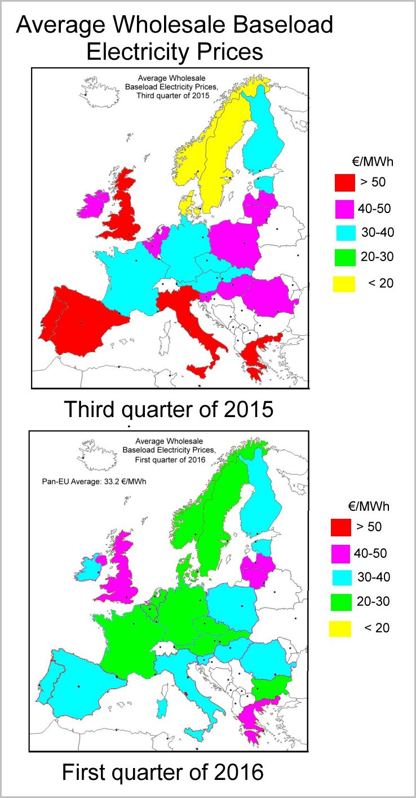
Both Markets and Grids need Improvements
Different wholesale prices reveal trade barriers in Europe
  Inefficient trading systems
  Grid bottlenecks
The electricity market systems must be improved
  More efficient market couplings between market systems
  Coordinated CRM (capacity remuneration mechanisms)
  Price zones in DE, AT and LU to optimize international trade
The grids must be reinforced, but only until the average price differences are reasonable
  Remaining variations must be absorbed by dispatchable resources
Challenges
  Delayed construction works in transmission
  Unequal distribution of cost and benefits between countries
  Introduction of price zones in DE, AT and LU (like Sweden in 2010)
  Public acceptance of
    the new, large transmission facilities
    a supranational market authority
    a supranational grid planning and grid control

Slide 14
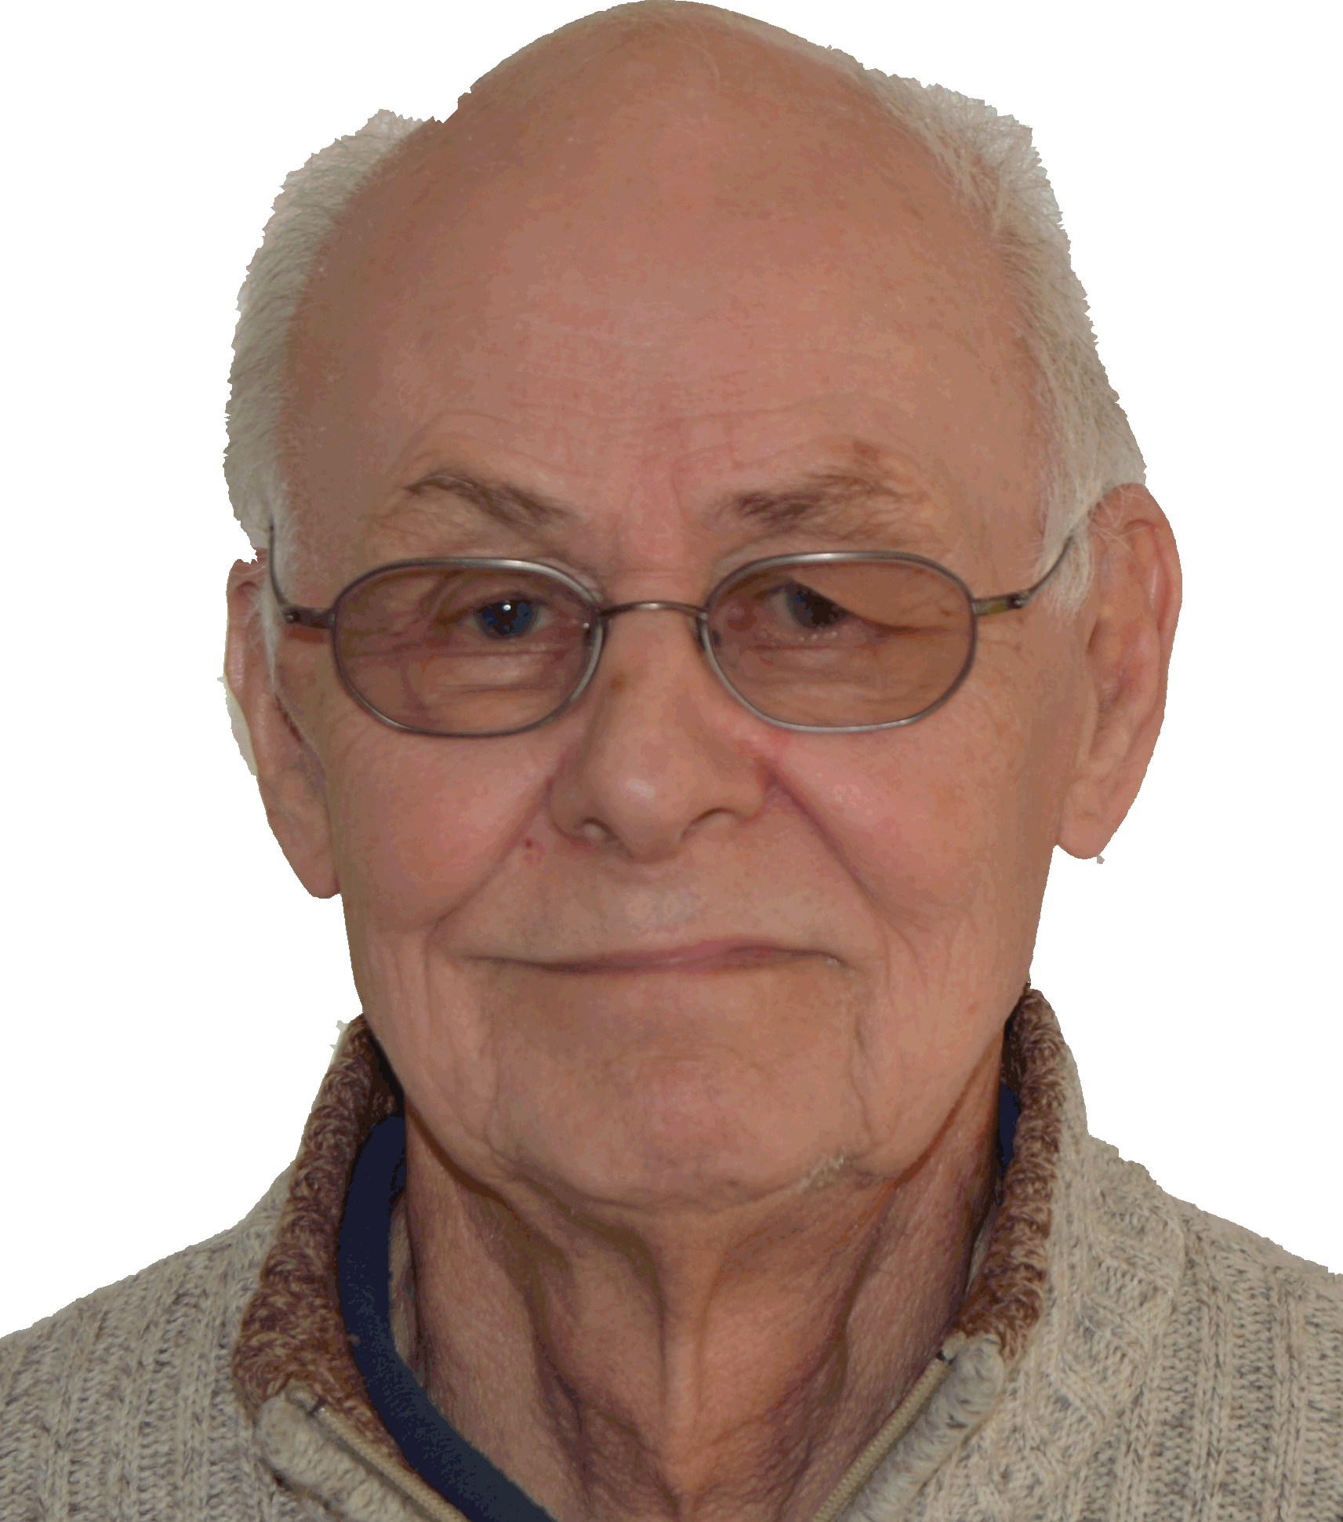
Paul-Frederik Bach
www.pfbach.dk

Slide 15
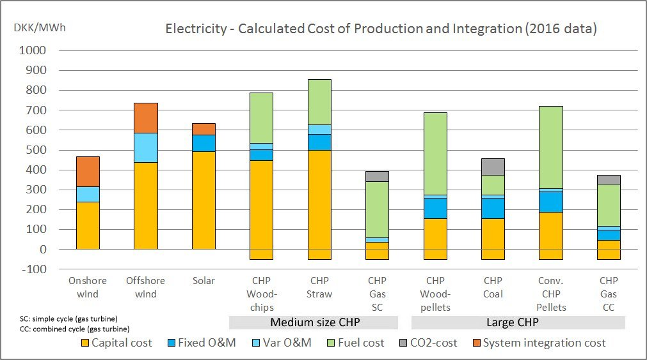
Cost Composition for Selected Technologies
Economy 3
CO₂-cost added for coal and gas units
External costs must be added for
coal and gas units to make
biomass technologies competitive
Medium size biomass has high
capital costs
Small units are not suitable for
biomass. They must continue on
gas or close.
Size matters!
**
*
* An integration value subtracted for dispatchable units
* * Error in model: missing fixed O&M
The future cost of system integration
is uncertain
System integration depends on local
and foreign dispatchable resources.
Onshore wind is an attractive technology, but it is hard to find locations
Could nearshore wind parks bring down the cost of wind energy?

