Slide 1
A School for the
21st Century
José Santos-Victor
VP International Affairs
santos.victor@ist.utl.pt

Slide 2
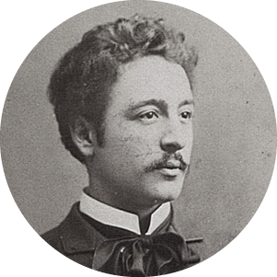
INSTITUTO SUPERIOR TÉCNICO was established with the objective of providing the country with Engineers with know-how and the necessary skills to succeed in their professional lives, while simultaneously contributing to the economic development of Portugal.
Alfredo Bensaúde
First Director of IST, 1911

Slide 3
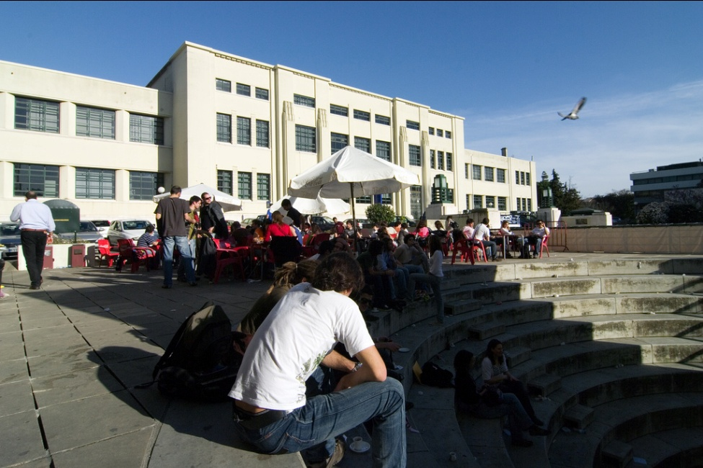
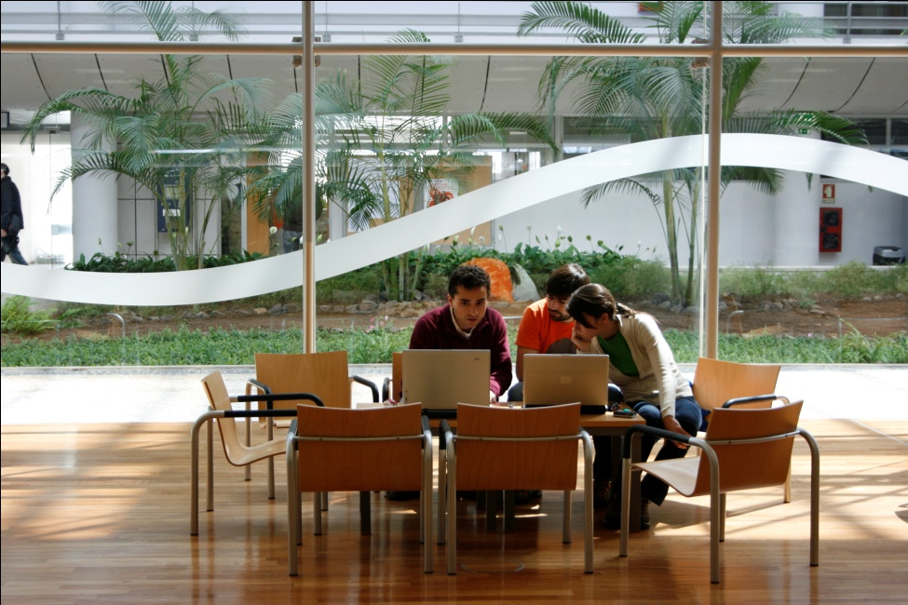
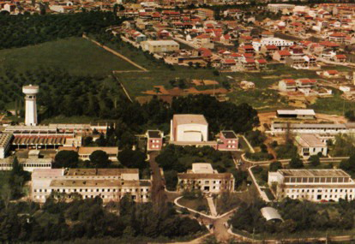
Campus Alameda
Located in one of the central-most parts of Lisbon, the Alameda Campus benefits from a transport network that facilitates mobility to all the areas of the city. In its vicinity, there are many shopping, leisure, culture, entertaining and sports areas.
Total area: 107 137 m2
Lisbon
Campus TagusPark
Integrated into the Science and Technology Park, known as Taguspark, one of the biggest and most important technological parks across the country, mainly in the area of ICT.
Total area: 17 186 m2
Oeiras
Campus Loures
One of the most important technology parks in the country, mainly in the area of Nuclear Science. Incorporates the Portuguese Research Reactor and the Radiological Protection and Safety Unit.
Loures

Slide 4
Facts & Figures
Foundation | 1911
Students | 11,458
1st cycle | 56%
Masters and PhD | 44%
International (M.Sc) | 13%
International (PhD) | 21%
Teaching Language (M.Sc, PhD) | Eng
Faculty | 871
Staff | 718
44%
Master and PhD students
56%
1st cycle students
2014 Shanghai Ranking (engineering): top 100 worldwide, top 20 in Europe
2014 US News Ranking (engineering): top 75 worldwide, top 15 in Europe

Slide 5
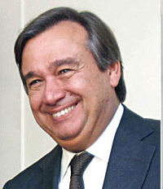
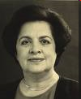
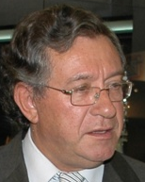
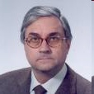
Outstanding Alumni
Prime
Ministers
Ministers
for Education
Luis Veiga da Cunha
Minister for Education, (1979-80)
Fraústo da Silva
Minister for Education (1982-83)
Roberto Carneiro
Minister for Education (1987-91)
Diamantino Durão
Minister for Education (1991-92),
President of IST (1984-91, 1993-2000)
António Couto dos Santos
Minister for Youth (1987-91)
Parliamentary Affairs (1991-92)
Minister for Education (1993-95)
Eduardo Marçal Grilo
Minister for Education (1995-99)
Administrator, Gulbenkian Foundation
António Guterres
Prime Minister of Portugal (1995-2002),
UN High-Commissioner for the Refugees.
Maria de Lurdes Pintassilgo
Prime Minister of Portugal (1979-80)
A. Nobre da Costa
Prime Minister of Portugal (1978)
Minister for Industry & Technology (1975-76)
Duarte Pacheco
Mayor of Lisbon (1938)
Minister for Public Instruction (1928)
Public Works and Communications (1932-36, 1938-43)
President of IST (1927-28, 1936-38)

Slide 6
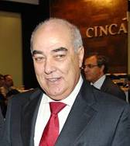
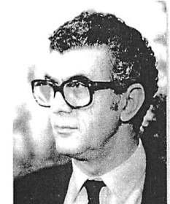
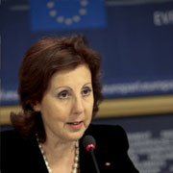
Outstanding Alumni
Ministers for Science & Technology
Ministers
for other areas
Maria Graça Carvalho
Minister for Science and Education, (2004)
Principal Adviser EC President Barroso
José Mariano Gago
Minister for Science & Technology (1995-2002)
Minister for Science, Technology &Higher Education
(2005-09, 2009-11)
Eduardo Pereira
Minister for Housing, Urban Planning & Construction (1976), Minister Internal Affairs (1983)
Fernando Faria de Oliveira
Minister for Commerce and Tourism (1990-91)
J.Ferreira do Amaral
Minister for Commerce and Tourism (1985-90)
Public Works and Communications (1990-95)
Mário Lino Correia
Minister for Public Works, Transports and Communications (2005-2009)
Nunes Correia
Minister for the Environment, Territory and Regional Development (2005-2009).
Bayão Horta
Defense Minister (1982)
Minister of Industry, Energy and Exports (1981,1982)
Luís Mira Amaral
Minister for Industry and Energy (1985-87), Minister of Labour & Social Security (1987-1995)
Maria Graça Carvalho
Member EU Parliament (2009- )
Ministers for Industry & Energy
European Governance
João Caraça
Member of the Board of the EIT

Slide 7
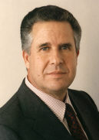
Outstanding Alumni
João de Deus Pinheiro
EU Commissioner
1993-95 Culture & communication
1995-1999 Relations with ACP Countries
EU Commissioners
Antonio Cardoso e Cunha, Portugal, 1989–1993
1986, Commissioner of Fishing and Marine Subjects.
1989 Commissioner of Energy, companies, industries, administration, audit and fights anti-fraud
Carlos Moedas
EU Commissioner
Research and innovation 2014-2020

Slide 8
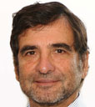
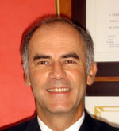
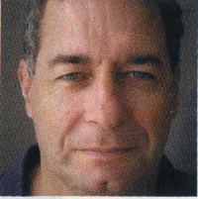
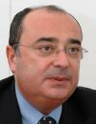
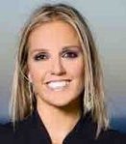
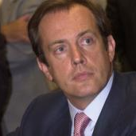
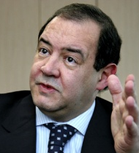
Outstanding Alumni
in the Corporate World
Fernando Faria de Oliveira
Chairman Caixa Geral de Depósitos
António Costa Silva
CEO Partex Oil &Gas
Rogério Carapuça
Chairman, NOVABASE
António Vidigal
CEO EDP Inovação
Joaquim Sérvulo Rodrigues
CEO ES Ventures
José Epifanio da Franca
CEO Chipidea
António Câmara
CEO Ydreams
Luis Pardal
CEO REFER
M Payes do Amaral
Founder Media Capital
Chairman TVI
F. Cardoso dos Reis
CEO Metropolitano
Cláudia Goya
CEO Microsoft Portugal

Slide 9
2
Education

Slide 10
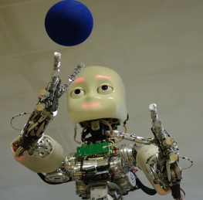
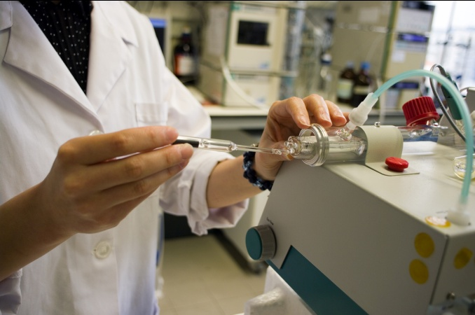
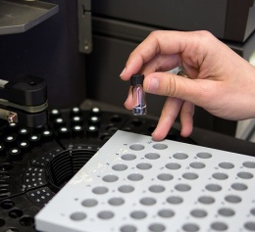
Graduate programmes
Alameda Campus
Bioengineering and Nanosystems
Biotechnology
Chemistry
Complex Transport Infrastructure Systems (w/ MIT)
Computer Science and Engineering
Construction and Rehabilitation
Information Systems and Computer Engineering
Materials Engineering
Mathematics and Applications
Mining and Geological Engineering
Naval Architecture and Marine Engineering
Pharmaceutical Engineering
Structural Engineering
Territorial Engineering
Transport Infrastructure Engineering
Transport Planning and Operation
Urban Studies and Territorial Management
Aerospace Engineering
Architecture
Biological Engineering
Biomedical Engineering
Biomedical Technologies
Chemical Engineering
Civil Engineering
Electrical and Computer Engineering
Engineering and Water Management
Engineering Physics
Environmental Engineering
Mechanical Engineering
Petroleum Engineering
3+2 ^{yrs or M.Sc (2yr)}
5 ^{yrs (Integrated Master)}
Taguspark Campus
Lifelong
Communication Networks Engineering
Electronics Engineering
Engineering and Industrial Management
Information Systems and Computer Engineering
10
3+2 ^{yrs or M.Sc (2yr)}
PhD
Graduate

Slide 11
Doctoral programmes
Aerospace Engineering
Architecture
Bioengineering
Biomedical Engineering
Biotechnology
Chemical Engineering
Chemistry
Civil Engineering
Climate Changes and Sustainable Development Policy
Computational Engineering
Computer Science and Engineering
Electrical and Computer Engineering
Engineering and Management
Engineering and Public Policy
Environmental Engineering
Geo-Resources
Information Security
Information Systems and Computer Engineering
Leaders for the Technical Industries
Materials Engineering
Mathematics
Mechanical Engineering
Naval Architecture and Marine Engineering
Physics
Refining, Petrochemical and Chemical Engineering
River Restoration and Management
Statistics and Stochastic Processes
Sustainable Energy Systems
Technological Change and Entrepreneurship
Engineering Physics
Territorial Engineering
Transportation
*
*
*
*
*
*
*
Lifelong
with Massachusetts Institute of Technology - MIT
with Carnegie Mellon University - CMU
with University Texas – Austin – UTA
with Ecole Polytech. Fédérale de Lausanne - EPFL
Graduate
PhD
*

Slide 12
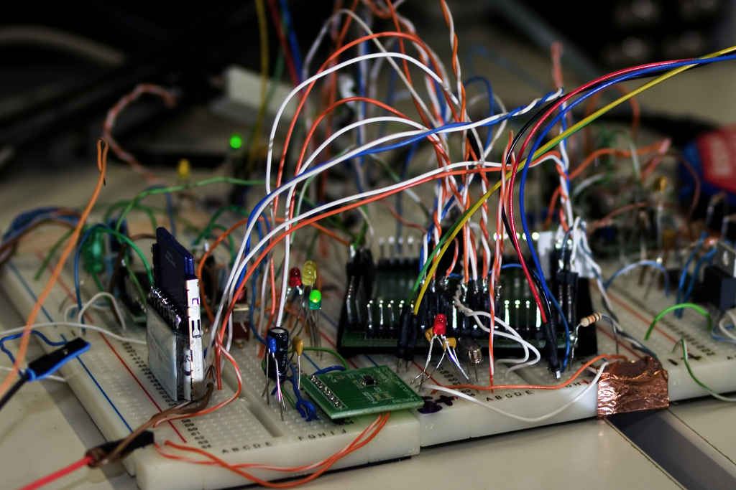
3
Research & Development

Slide 13
Research Areas
Information & Communication Technologies
Production Engineering and Technologies
Energy, Environment and Mobility
Basic Sciences
Applied Life
Sciences
Technology Management & Entrepreneurship
Materials Microtechnology
Nanoscience

Slide 14
Associate Laboratories
IT
Institute for Telecommunications
LARSyS
Robotics & Systems in Engineering and Science
LAETA
Laboratory for Energy, Transports and Aeronautics
IN
Institute of Nanotechnologies
IBB
Institute for Biotechnology and Bioengineering
INESC-ID
Institute for Systems
and Computer Engineering
IPFN
Institute for Plasmas and Nuclear Fusion
Notes:
JP:
É o prof. q faz esta distinção? Quase parece q está a repetir… não está muito feliz esta dupla de slides. Não seria preferivel por tudo num??
IST’s links with society encompass training of human resources, provision of services, knowledge discrimination and technology transfer. IST is involved with some of the most prestigious national R&D and technology transfer institutions, such as ICIST (civil engineering and architecture), IDMEC (mechanical engineering), ISR (robotics), IT (telecommunications), ICTPOL (polymers), ICTM (materials), and ICEMS (materials and surfaces). Participation in these institutes is an important mechanism for establishing links with the business world.

Slide 15
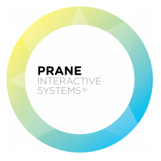
Notes:
Actualizado de acordo com tt.ist.utl.pt (Julho 2012)
+ empresas taguspark
45 spin-offs

Slide 16
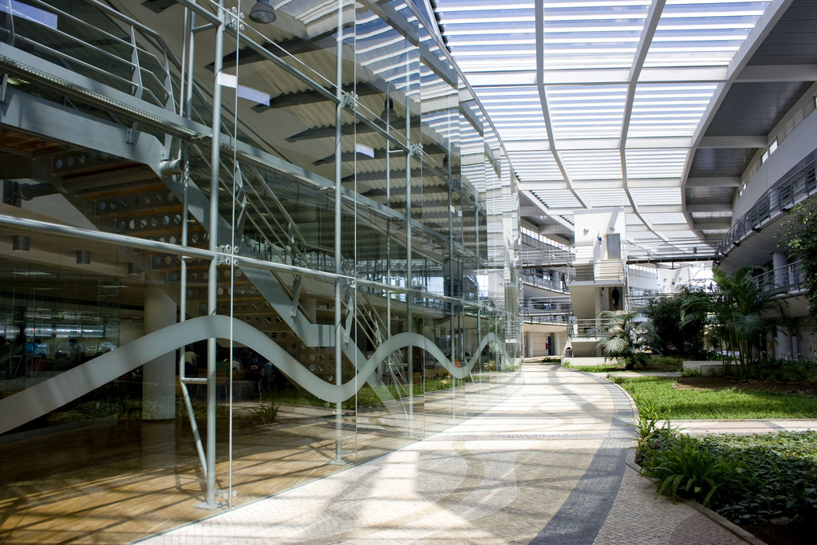
5
Internationalisation

Slide 17
Participation in Academic Networks
CLUSTER - Consortium Linking Universities of Science and Technology for Education and Research
TIME - Top Industrial Managers for Europe
CESAER - Conference of European Schools for Advanced Engineering Education and Research
CINDA - Centro Interuniversitario de Desarrollo
SEFI - European Society for Engineering Education

Slide 18
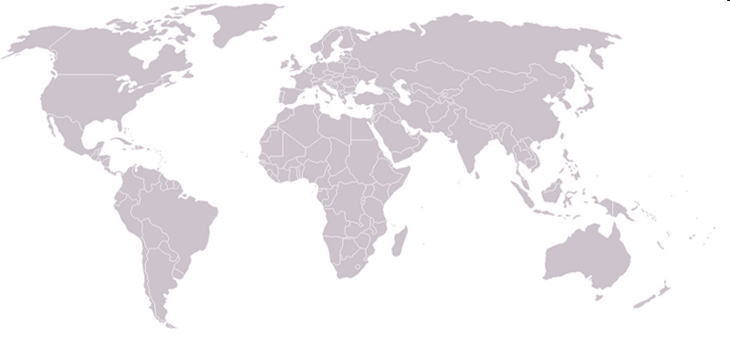
Premier Partnerships
Associate Members
Poli-USP

Slide 19
Joint Degrees*
MIT
(Massachusetts Institute of Technology)
CMU
(Carnegie Mellon University)
UT/Austin
(University of Texas at Austin)
EPFL
(Ecole Polytechnique Federale de Lausanne)
TIME
Politecnico di Milano; Università Padova; Università Trento; Moscow; Écoles Centrales Paris, Lille, Lyon, Nantes.
CLUSTER
KTH (Sweden), UPC (Spain), AALTO (Finland), UCLouvain (BE)
and MORE …..
Universidade de São Paulo, TUDelf, SupAero, UFRJ, UniCAMP,
“Joint”: understood as joint, dual/double or in collaboration.

Slide 20
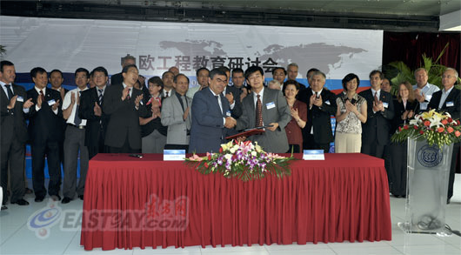
SEEEP
Sino-European Engineering Education Platform
CHINA
Tongji U.,
Harbin Institute of Technology, Tianjin U.,
Tsinghua U.,
Xi’an Jiao Tong,
Dalian U. Technology,
Huazhong U. S&T,
Southeast U.,
Zhejjiang U., Shanghai Jiaotong, South China U. of S&T, U. of Science and Technology Beijing, Beijing Jiatong U.,
China U. of Petroleum,
China U. of Mining and Technology,
Beijing U. of Posts & Telecomm.,
East China U. Science & Techn., Sichuan University.
CLUSTER KTH, Stockholm, Sweden, Aalto University Helsinki,
TUe, the Netherlands, EPFL, Switzerland,
Grenoble INP, Polito, Italy,
KIT, Germany, TU-Darmstadt, Germany
UC Louvain/KU Leuven
Trinity College Dublin, UPCatalonia, Spain,
IST Lisbon, Portugal.

Slide 21
Cooperation with Chinese Universities
University of Macao, Macao SAR
Beijing Institute of Technology
Tsinghua University
Zhejiang University
Tongji University
Tianjin University
Dalian University
Harbin University
Chinese University of HK, HK SAR
Beijing Jiaotong University
Research Internships
Student Exchange
Staff Exchange
Master Thesis
Joint Doctorates

Slide 23
Partnerships for Student Mobility
External Cooperation & Promotion of European HE
Joint Programmes
Systems Biology
(euSYSBIO)
Distributed Computing
(EMDC)
MASTER
WELCOME
(Egypt, Lebanon)
ARCO-IRIS
(Argentina)
HERITAGE, NAMASTE
(India)
ANGLE
(Africa, Caribbean, Pacific)
EUROEAST
(Eastern Europe)
EUBrazil Start!up
(Brazil)
ADDE SALEM
(Argentina, Brazil, Chile, Colombia)
Functional Materials
(IDS-FunMat)
Distributed Computing (JDDC)
Plasma Physics
(Fusion DC)
Sustainable Energy
(SELECT+)
Computational Mechanics
(SEED)
DOCTORATE
Notes:
JP: billateral está bem escrito??

Slide 24
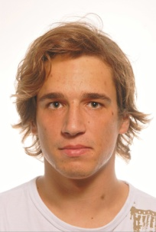
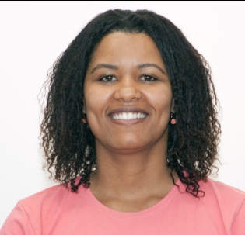
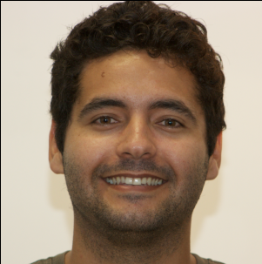
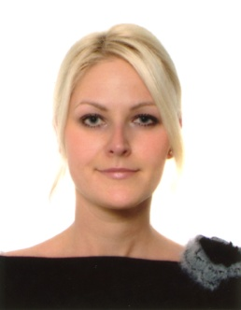
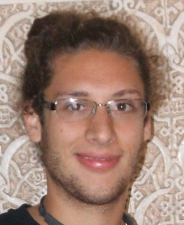
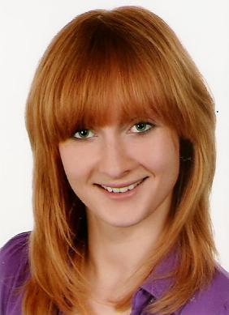
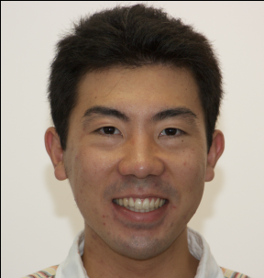
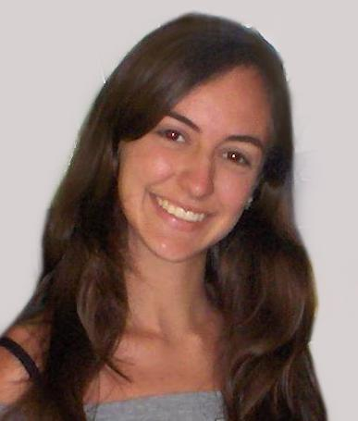
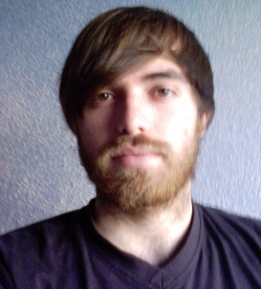
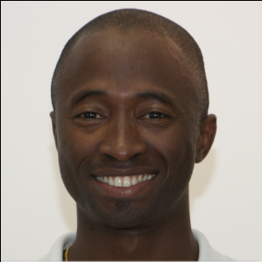
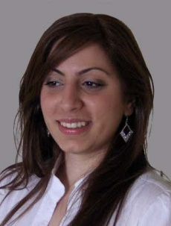
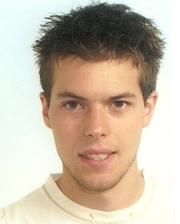
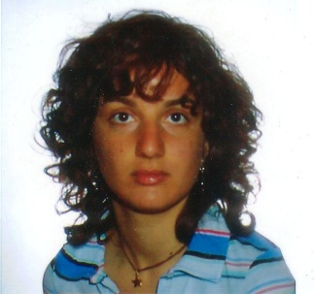
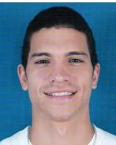
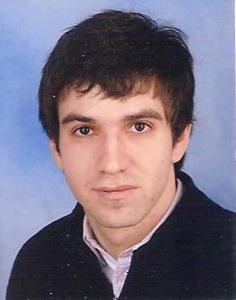
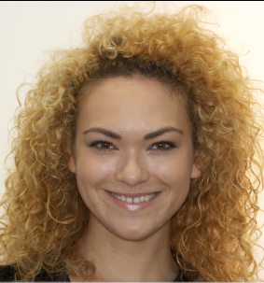
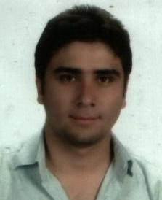
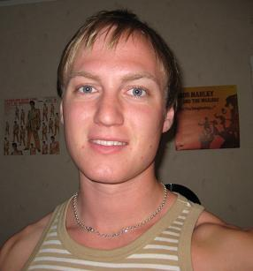
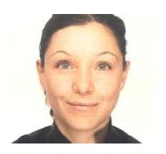
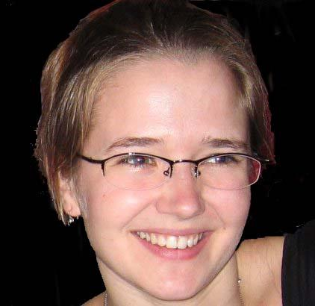
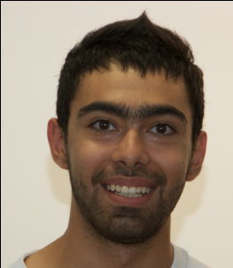
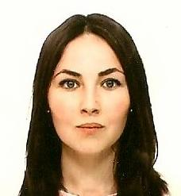
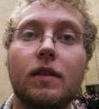
... Diversity!

Slide 25
6
The IST Experience

Slide 26
Welcome to Lisbon
Nations Park
Trams
Belém Tower
Tagus River
Traditions
Downtown
Rossio
Beaches

Slide 28
This is...

