Slide 1
John Constable Energy, Entropy and the Theory of Wealth
Based on a public lecture at the University of Newcastle, February 2016
John Constable is the director of REF Renewable Energy Foundation
http://www.ref.org.uk/index.php
Link to the full text: http://www.libellus.co.uk/uploads/jc_energy_entropy_wealth_2016.pdf
The study offers an ontological theory of wealth grounded in thermodynamics
Wealth is a complex, low entropy state of matter, satisfying, however, indirectly, human demands.
These complex states of matter: include: Ideas, Tools, Institutions, Bridges, Improved land
Typically they are energised to create further order
Such states are themselves the result of energy conversions
Thus wealth creating activity (of which economic activity is a subset) creates local order (low entropy) where it is required, and disorder (higher entropy) elsewhere
Fuels (low entropy) are degraded into heat such as lukewarm water (higher entropy)
Non-energy natural resources are typically reduced in entropy by energy consumption (and then degraded during use)
Economic history records the progressive (very slow) reduction of the entropy of the human sphere permitting the use of denser and more difficult energy resources with a higher energy return on energy invested (EROEI)

Slide 2
Conclusion
Energy is not just another input: the directionality of thermodynamics tells us that energy is the primary driver of economic activity over time, accounting both for existing wealth (capital) and current output.
Grounds for concern:
We are not running out of energy, but simple availability is not enough: societies must maintain a very low entropy state in the human sphere to make use of the energy actually available
A green future is conceivable, but it will be like all the other improbable futures that men and women have made for themselves: It will be far from the thermodynamic equilibrium, and will require very dense sources of energy with a high energy return on energy invested
Current most renewable energy policies at the global level are not likely to deliver this outcome.

Slide 3
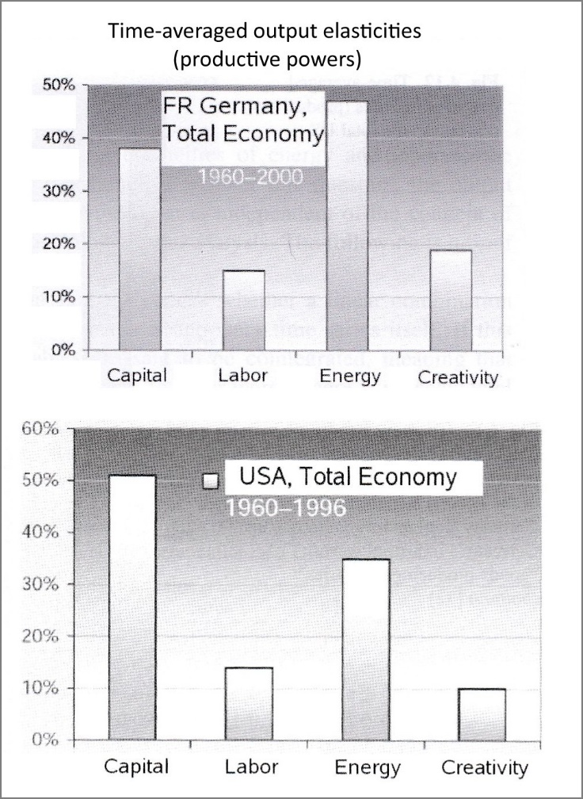
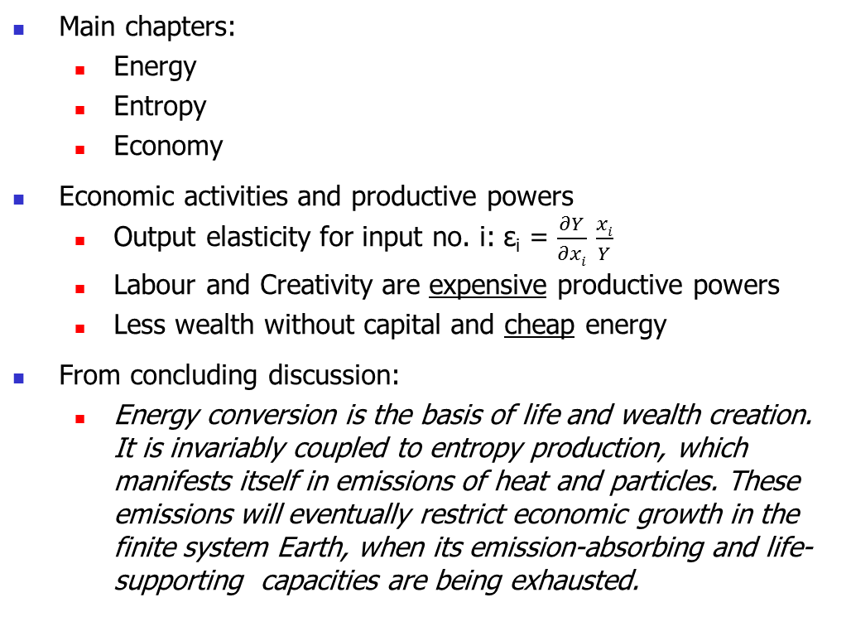
A Scientific Approach
Reiner Kümmel:
The Second Law of Economics – Energy, Entropy, and the Origins of Wealth
Main chapters:
Energy
Entropy
Economy
Economic activities and productive powers
Output elasticity for input no. i: ε_{i} = $\frac{∂Y}{∂xi}$ $\frac{xi}{Y}$
Labour and Creativity are expensive productive powers
Less wealth without capital and cheap energy
From concluding discussion:
Energy conversion is the basis of life and wealth creation. It is invariably coupled to entropy production, which manifests itself in emissions of heat and particles. These emissions will eventually restrict economic growth in the finite system Earth, when its emission-absorbing and life-supporting capacities are being exhausted.

